Slide 1
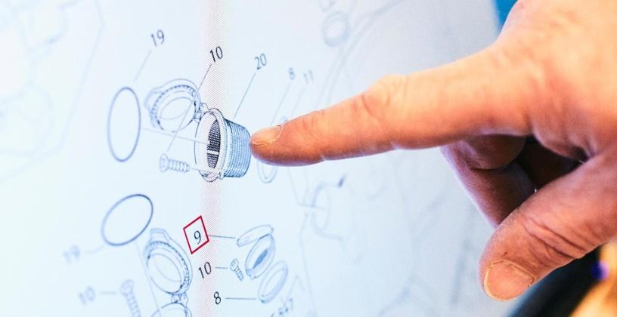
MC2C Facelift

Slide 2
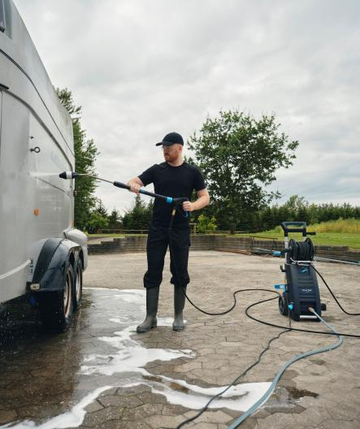
Content
1
Background & product benefits
2
Segments & applications
3
Technical specification
4
PAC
5
Key competitor comparison

Slide 3
1
Background & product benefits

Slide 4
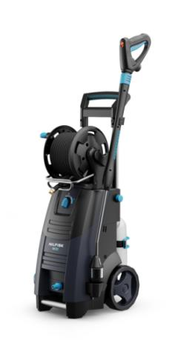
Background
MC2C
Versatile compact performance
The Nilfisk MC2C - focused, flexible and compact cold water pressure washers with good performance for a variety of cleaning tasks.
The Nilfisk MC2C is an entry level cold water HPWs but has the most on machine and nozzle adjustability of the cold water HPW portfolio.
The machine is highly versatile and can adapt to a wide range of smaller daily or weekly cleaning tasks.
Small footprint machine with 4-in-1 nozzle, hose reel, and foam sprayer with quick setup and stowaway making this machine a powerful compact performer.

Slide 5
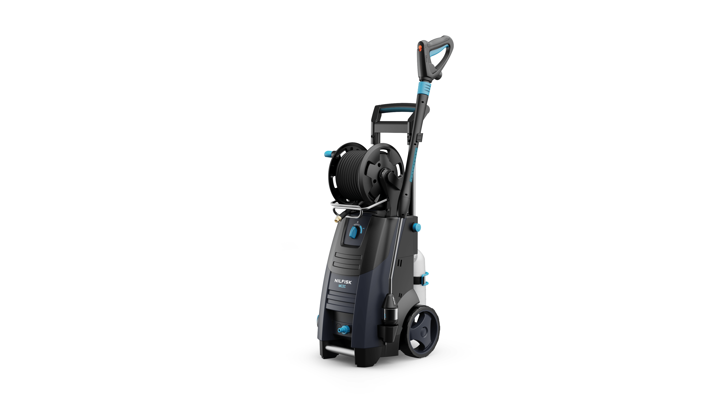
MC2C product benefits
Key selling points
Ergo Spray Gun
Ergonomic accessory concept that improves handling and reduces strain
Hose Reel
Guided hose-reel for an easy, one-handed rollup and protected hose storage
*only on selected machines
Steel armed hose
10-15 metre of durable and flexible hose
Rotatable cable hook
Fast and easy power cable management (twist-off concept) for quick setup and stowaway
Telescopic handle
Easy transport and storage
Water flow regulation
Easy water-flow regulation for a quick adjustment according to the cleaning tasks
Foam Sprayer
Powerful detergent application with universal foam sprayer – easy to use
Gardena coupling
Easy set-up and stowaway
4-in-1 nozzle ensures easy change between nozzles – always the right nozzle for almost all cleaning tasks and applications
*only on selected machines
Auto Start Stop
Motor stops when the trigger is deactivated. No noise during work pauses. Saves energy

Slide 6
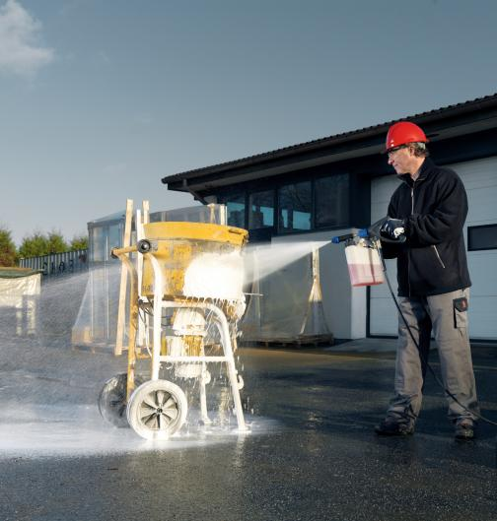
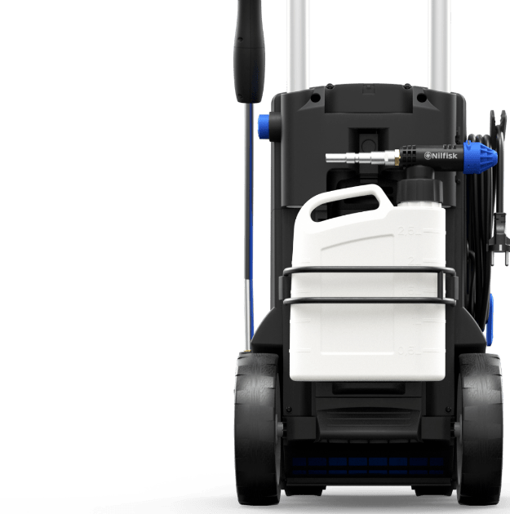
MC2C
Foam Sprayer included
Foam Sprayer
The external foam cannon provides a fixed dosing at 3%, delivering thick, sticky foam that increases cleaning efficiency.
For cleaning of cars, vehicles, tools or any vertical surface a foam spayer is superior compared to internal detergent systems as the foam from the included foam sprayer creates thick foam that sticks to surfaces which increase the time the detergent can work on the surface. This results in
a more effective clean and less water and electrical usage.
The model is delivered with a foam cannon and 2.5L tank that can be attached to the sprayer unit.
Easy storage
The backside of the MC2C offers a strong and easy storage solution for the 2.5L detergent tank.

Slide 7
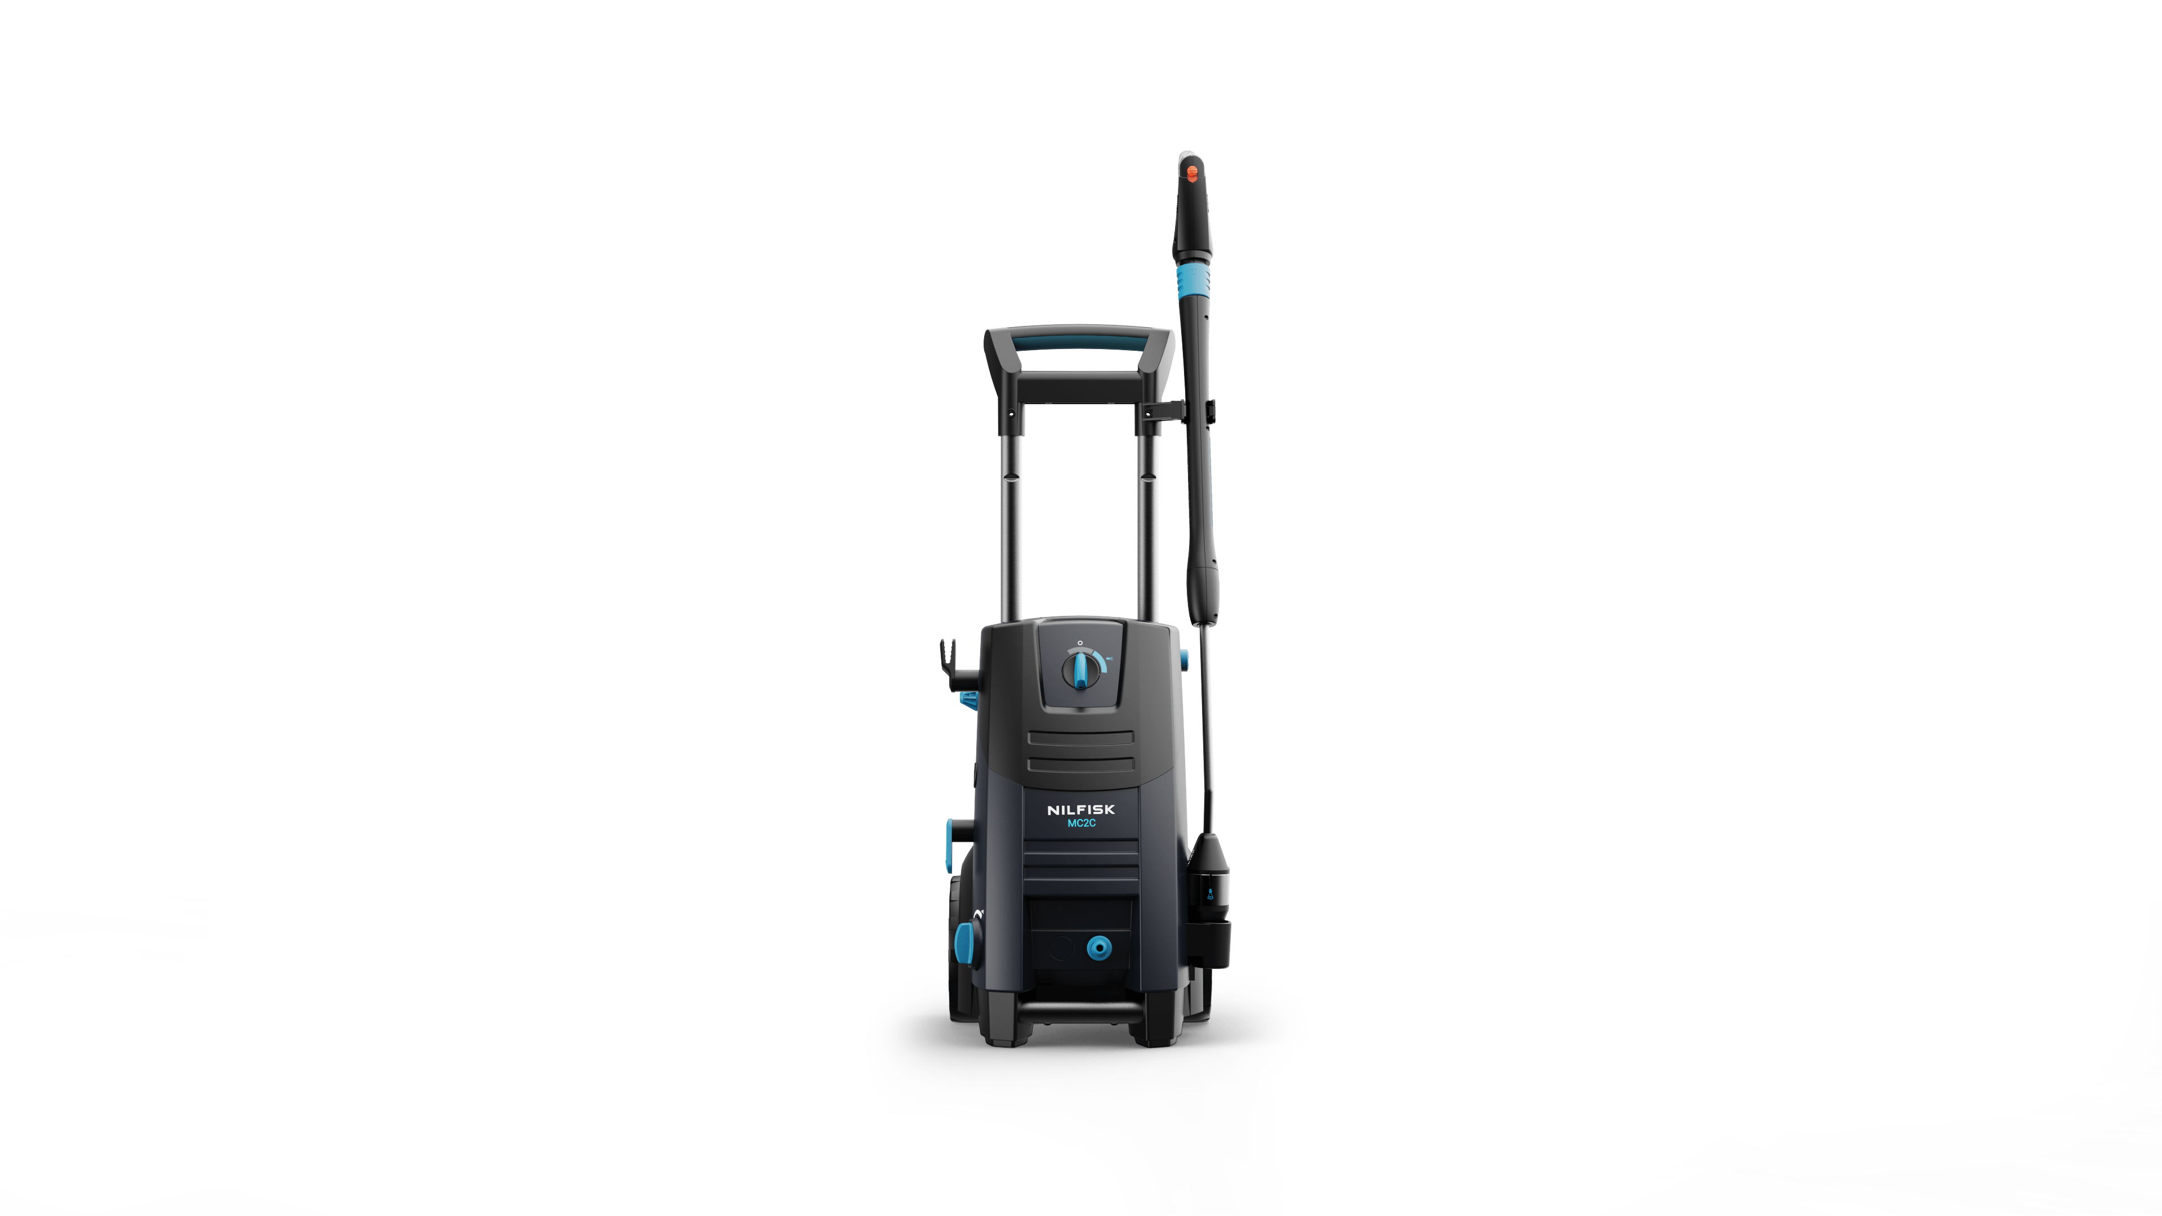
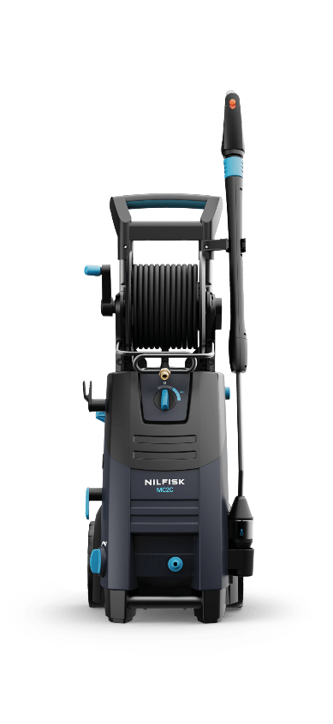
Product variants
 | MC2C | MC2C T | MC2C XT
FlexoPower nozzle | •
4-in-1 nozzle |  | • | •
Hose hook | • | •
Hose reel |  |  | •
10m hose | •
15m hose |  | • | •
Foam Sprayer | • | • | •

Slide 8
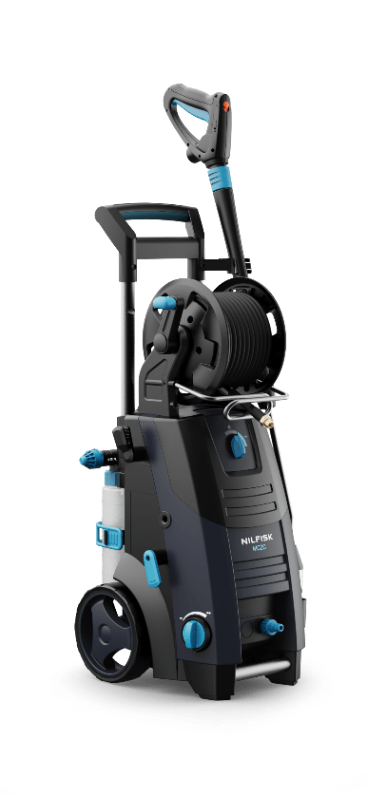
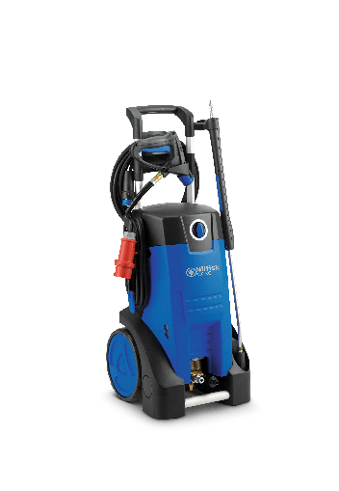
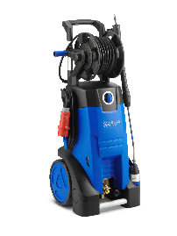
Compact/mid entry HPW range
Which product is best for which use?
1-2 hrs/day
1-phase
1x detergent
2800 RPM motor
3-piston pump
Stainless steel pistions
Direct auto start/stop
Inlet temp 60ºC
Pressure activation
1-3 hrs/day
1- & 3-phase
Foam cannon
2800 RPM motor
3-piston pump
Ceramic pistons
Direct auto start/stop
Inlet temp 60ºC
Pump-oil tank
Spray-gun holder
Pressure activation
1-4 hrs/day
1- & 3-phase
Foam cannon
1450 RPM motor
3-piston pump
Ceramic pistons
Direct auto start/stop
Inlet temp 60ºC
Pump-oil tank
Spray-gun holder
Pressure activation
MC2C
MC3C
MC4M

Slide 9
2
Segments & applications

Slide 10
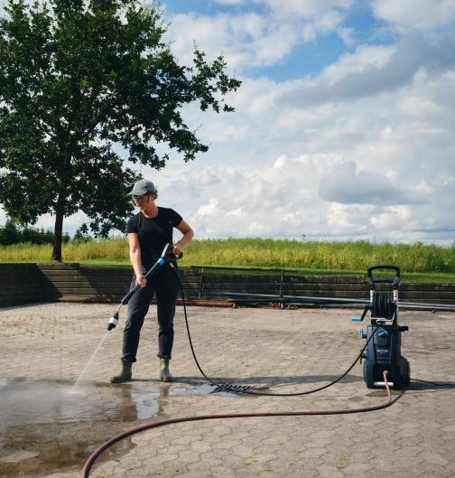


Segments
Applications
Key Target Segments
Prosumer
Professional user
Key Applications and JTBD
Surfaces
Car & vehicle cleaning
Trailers
Tools & equipment

Slide 11
Primary area of applications
MC2C
is recommended for up to 2 hours of use a day or small to medium weekly/bi-weekly/monthly
cleaning tasks.
The MC2C is ideal for consumer that want higher quality or professional users that wants a HPW for smaller jobs or as a number two HPW. It excels at:
Automotive
Car and vehicle cleaning
Trailers and campers
Agriculture
Smaller equipment and vehicles
Spot cleaning
Building & Construction
Cleaning of vehicles
Cleaning of tools and equipment
Surface/facade cleaning
Contract Cleaners
Light cleaning of car parks, forecourts
Outdoor areas
Driveway and patio cleaning

Slide 12
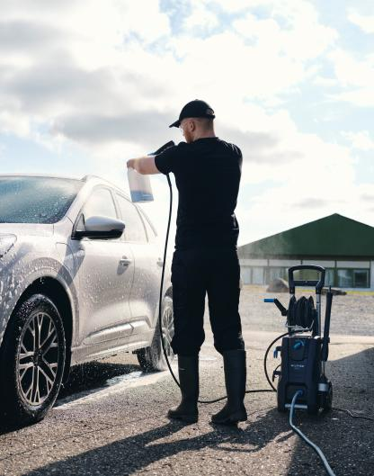
Segments and applications
Automotive
From small car cleaning business to garages or dealerships
Cleaning of cars, vans, trailers
Smaller jobs such as engine bays, wheels, or undercarriage*
* In combination with detergent if hot water is not preferred

Slide 13
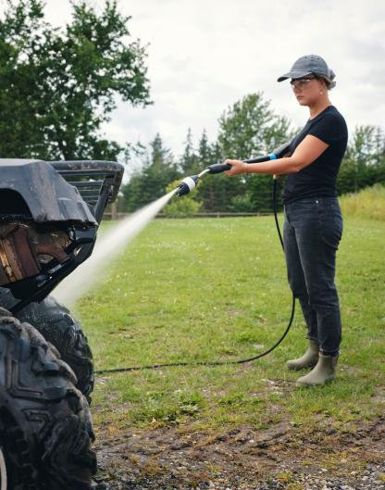
Segments and applications
Agriculture
From small hobby farms to animal farms
Cleaning of agricultural equipment and vehicles
Cleaning of tools and milking

Slide 14
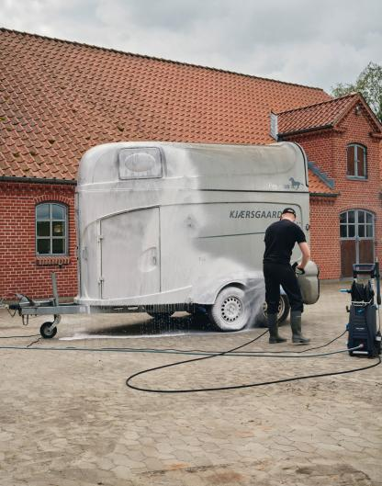
Segments and applications
Tradesmen, masons
and painters
Main cleaning tasks
Small construction sites
Cleaning of tools and equipment
Removal of mud, sand, and encrusted dirt; hot water isn’t needed.

Slide 15
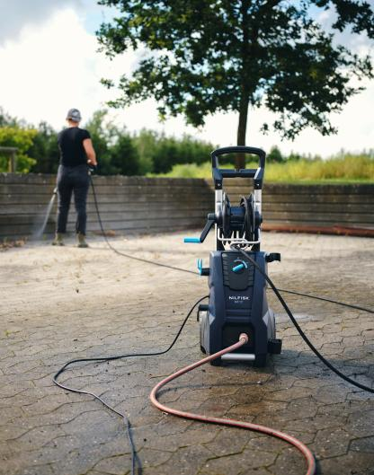
Segments and applications
Small contract cleaners
Light cleaning of car parks, forecourts
Outdoor areas
Driveway and patio cleaning

Slide 16
3
Technical specification

Slide 17
Technical specifications
 | MC2C 120/520 T | MC2C 120/520 XT | MC2C 140/610 XT | MC2C 150/650 | MC2C 150/650 XT
Item no. | 128471493 (EU) 128471494 (UK) | 128471490 (EU) 128471491 (AU) 128471492 (CH) | 128471495 (EU) 128471496 (UK) | 128471497 (EU) 128471499 (Expt.) | 128471498 (EU)
Pressure & flow (working pressure/max flow) | 120/520 | 120/520 | 140/610 | 150/650 140/650 (Expt.) | 150/650
Electrical | 230/1/50/10 | 230/1/50/10 | 230/1/50/12,6 | 230/1/50/14,5 220/1/60/14,5 | 230/1/50/14,5
Recommended minimum fuse needed (A) | 10 | 10 | 13 | 16 | 16
Power consumption (kw) | 2,3 | 2,3 | 2,9 | 3,3 | 3,3
Pump & pistons | PRO & stainless steel | PRO & stainless steel | PRO & stainless steel | PRO & stainless steel | PRO & stainless steel
Motor rpm | 2800 | 2800 | 2800 | 2800 | 2800
Spray gun | Ergo 2000 | Ergo 2000 | Ergo 2000 | Ergo 2000 | Ergo 2000
Lance and nozzle | 4-in-1 nozzle | 4-in-1 nozzle | 4-in-1 nozzle | FlexoPower 990 | 4-in-1 nozzle
Hose reel | No | Yes | Yes | No | Yes
Hose length (m) | 10 | 15 | 15 | 10 | 15
Foam Sprayer | Yes – 2.5L bottle w. 3% fixed dosing | Yes – 2.5L bottle w. 3% fixed dosing | Yes – 2.5L bottle w. 3% fixed dosing | Yes – 2.5L bottle w. 3% fixed dosing | Yes – 2.5L bottle w. 3% fixed dosing
Dimensions | 394*391*955 | 394*391*955 | 394*391*955 | 394*391*955 | 394*391*955
Weight (kg) | 27.3 | 28.1 | 28.1 | 26.3 | 28.1

Slide 18
Features
 | MC2C 120/520 T | MC2C 120/520 XT | MC2C 140/610 XT | MC2C 150/650 | MC2C 150/650 XT
Item no. | 128471493 (EU) 128471494 (UK) | 128471490 (EU) 128471491 (AU) 128471492 (CH) | 128471495 (EU) 128471496 (UK) | 128471497 (EU) 128471499 (Expt.) | 128471498 (EU)
Spray gun | Ergo 2000 | Ergo 2000 | Ergo 2000 | Ergo 2000 | Ergo 2000
Lance and nozzle | 4-in-1 nozzle | 4-in-1 nozzle | 4-in-1 nozzle | FlexoPower 990 | 4-in-1 nozzle
Hose reel | No | Yes | Yes | No | Yes
Hose length (m) | 10 | 15 | 15 | 10 | 15
Foam sprayer | Yes – 2.5L bottle w. 3% fixed dosing | Yes – 2.5L bottle w. 3% fixed dosing | Yes – 2.5L bottle w. 3% fixed dosing | Yes – 2.5L bottle w. 3% fixed dosing | Yes – 2.5L bottle w. 3% fixed dosing
Twist off cable hook | Yes | Yes | Yes | Yes | Yes
Water flow regulation | Yes | Yes | Yes | Yes | Yes
Auto start/stop | Yes | Yes | Yes | Yes | Yes
Telescopic handle | Yes | Yes | Yes | Yes | Yes

Slide 19
4
PAC

Slide 20
Accessories (in the box)
* Is not included in the box
 | MC1C 125/500 XT | MC2C 120/520 T | MC2C 120/520 XT | MC2C 140/610 XT | MC2C 150/650 | MC2C 150/650 XT
Item no. | 128471500 | 128471493 (EU) 128471494 (UK) | 128471490 (EU) 128471491 (AU) 128471492 (CH) | 128471495 (EU) 128471496 (UK) | 128471497 (EU) 128471499 (Expt.) | 128471498 (EU)
Ergo 2000 spray gun (old colour gun) | 106403122 | 106403122 | 106403122 | 106403122 | 106403122 | 106403122
4-in-1 nozzle | 128502053 | 128502054 | 128502054 | 128502054 | 128502054* | 128502054
Lance w. single nozzle | 128502047* | 128502049* | 128502049* | 128502049* | 128502049/128502050 | 128502049*
Hose | 128502079 | 128502079 | 6528613 | 6528613 | 128502079 | 6528613
Foam Sprayer wo. adjustment | 128502051* | 128502051 | 128502051 | 128502051 | 128502051 | 128502051
Foam Sprayer with adjustment + 1L bottle | 106408234* | 106408234* | 106408234* | 106408234* | 106408234* | 106408234*
Surface cleaner | 106403187* | 106403187* | 106403187* | 106403187* | 106403187* | 106403187*
Drain & tube cleaner | 128501789* | 128501789*/ 128501790*/ 128501791* | 128501789*/ 128501790*/ 128501791* | 128501789*/ 128501790*/ 128501791* | 128501789*/ 128501790*/ 128501791* | 128501789*/ 128501790*/ 128501791*

Slide 21
5
Key competitor comparison

Slide 22
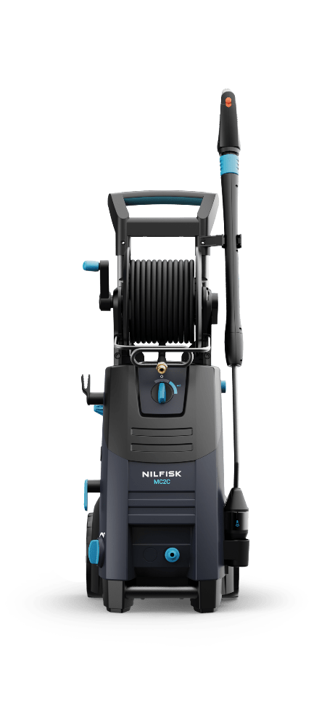


Product comparison
Nilfisk vs. Kärcher
 |  | MC 2C – 125/520 | MC 2C – 140/610 | MC 2C – 150/650 |  | HD 5/12 | HD 5/15 | HD 5/17 | HD 6/13
Working pressure (bar) |  | 125 | 140 | 150 |  | 120 | 150 | 170 | 130
Flow (high/low) |  | 470/520 | 540/610 | 570/650 |  | 500 | 500 | 480 | 590
Main USPs |  | Ergo gun, 4-in-1 lance, with or with hose reel, 15m hose, pressure/ flow adjustment, foam sprayer. |  |  |  | EASY! Force gun, 3-in-1 nozzle, with or without hose reel, dirt blaster.

Slide 23



MC2C – characteristics, advantages, and benefits
Comfort of use
Characteristics
Stainless steel Universal Plus lance including 4-in-1 nozzle*
Adjustable telescopic aluminium handle
Ergo quick coupling concept
Hose swivel/anti twist
Hose reel with hose guide in aluminum*
Turnable cable hook
10 - 15 metre steel-armed hose*
Light blue touchpoints
Advantages
No need to change or buy additional
lance and nozzle
Easy transport & compact storage
Easy to assemble and disassemble without tools
Less kinks and twists in the hose
Easy to un-roll and wind-up
Easy setup and stowaway
Large cleaning areas
Clear indication of operation points
Benefits
Convenient nozzle selection for quick adjustments during cleaning or steps
of cleaning
Easy to put in the trunk of a car or van.
Can fit in small spaces. Small footprint
No tools needed and quick change of acc.
Better hose experience
Easy and smooth handling with one hand – less effort. Good protection of the hose
Reduce time handling the cable
Less need to move the machine
when cleaning
Intuitive use
*On selected machines

Slide 24
MC2C – characteristics, advantages, and benefits
Efficiency / performance
Characteristics
4-in-1 nozzle with rotating nozzle
Foam Sprayer
Water flow regulation
Advantages
Efficient cleaning effect on tough cleaing tasks
Fast and efficient application of any type of detergent + higher contact time with sticky foam = better clean
Adjust pressure / water flow usage for different cleaning tasks
Benefits
Reduce cleaning time on tough jobs on surfaces and tools
Better cleaning result with less detergent consumption then internal systems
More efficient clean with less water and electricity

Slide 25
MC2C – characteristics, advantages, and benefits
Cost of ownership
Characteristics
No MPU service needed
Hose reel with guide*
Included nozzle tips cleaing tool
Advantages
No downtime – MPU will run full lifetime
wo. service
Hose reel increases the lifetime of the steelarmed hose and protects the hose during use and storage
Easy and fast cleaning of clogged nozzles
Benefits
Low service costs
Increase the lifetime and reduce wear
on hose
Ensures optimal performance
*On selected machines

Slide 26
MC2C – characteristics, advantages, and benefits
Reliability & robustness
Characteristics
Steel armed hose
3 pistons pump with stainless steel pistons
Brushless induction motor
Auto start/stop
Thermal safety
Advantages
Flexible and durable
Solid performance with high resistance
to corrosion
Long lifetime and low sound level
Pumps automatically stops when trigger
is not pulled
Protects motor from overheating
Benefits
Long lifetime
Good performance throughout the lifetime
No service needed
Reduce wear during machine standby time
Increase lifetime and safety

