Slide 1
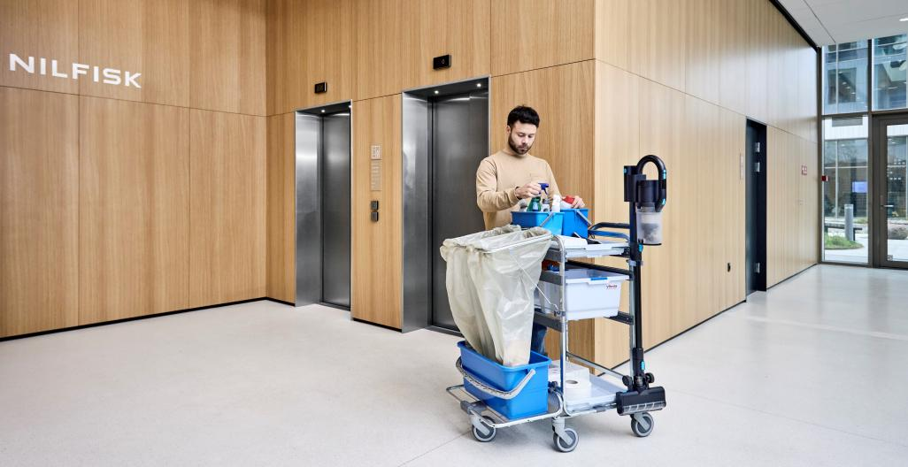
VU200
Internal presentation

Slide 2
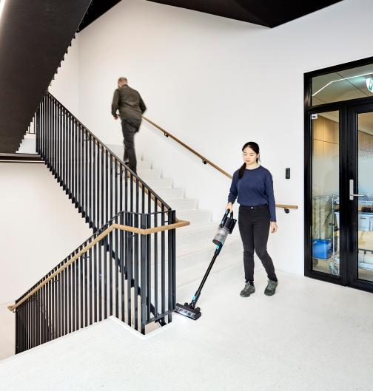
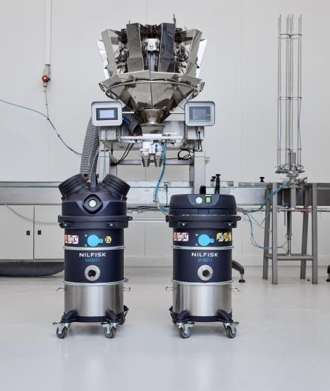
Contents
1
Value proposition
5
Features
2
Primary areas of applications
6
Durability testing
3
Product summary
7
Technical specification
4
Customer benefits
8
Accessories

Slide 3
1
Value proposition

Slide 4
Value proposition
Cordless stick vacuum
Definition of the category
Comfortably and quickly
Focus on the customer benefits
Spot clean without interrupting their workflow
Clear definition of the application;
Focusing on the value of efficiency: Using the VU200 allows to avoid any stop to the cleaning flow as you don’t need to plug a machine, just take it and use it.
Certified for professional use
Differentiator compared to consumer version
Always within reach
Focus on main product features
The VU200 cordless stick vacuum allows professional cleaners to comfortably and quickly spot clean without interrupting their workflow.
Certified for professional use and always within reach, it provides advanced filtration, is powerful, and easy to use.

Slide 5
2
Primary areas of applications

Slide 6
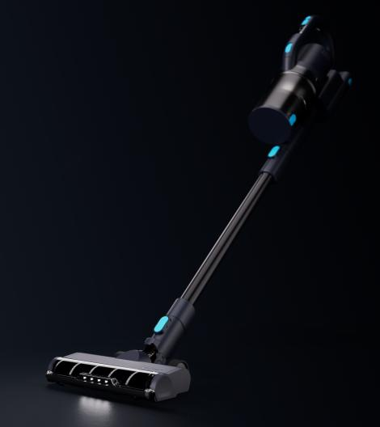
The product
Easy spot cleaning for professionals
Streamline your cleaning processes with the VU200: a powerful, versatile stick vacuum
cleaner certified for professional use
Equipped with a lithium-ion battery and specifically designed for easy spot cleaning,
the VU200 is light, comfortable and convenient

Slide 7





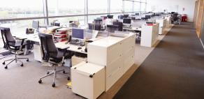
Target segments
Primary customers | CC&I
Contract cleaners
Institutions
Hospitality
Education
Retail
Public administration and offices

Slide 8
Cleaning tasks
 | Dusting | Furniture cleaning | Spot cleaning | Daily cleaning | Deep cleaning
Flexible hose
Combi brush
Brush
Crevice tool
Sofa Brush
Active brush
Hard floor roller
Carpet roller
Legend
0/4 suitable
1/4 suitable
2/4 suitable
3/4 suitable
4/4 suitable

Slide 9
3
Product summary

Slide 10
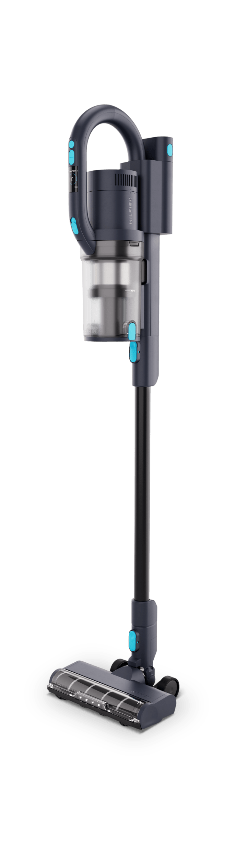
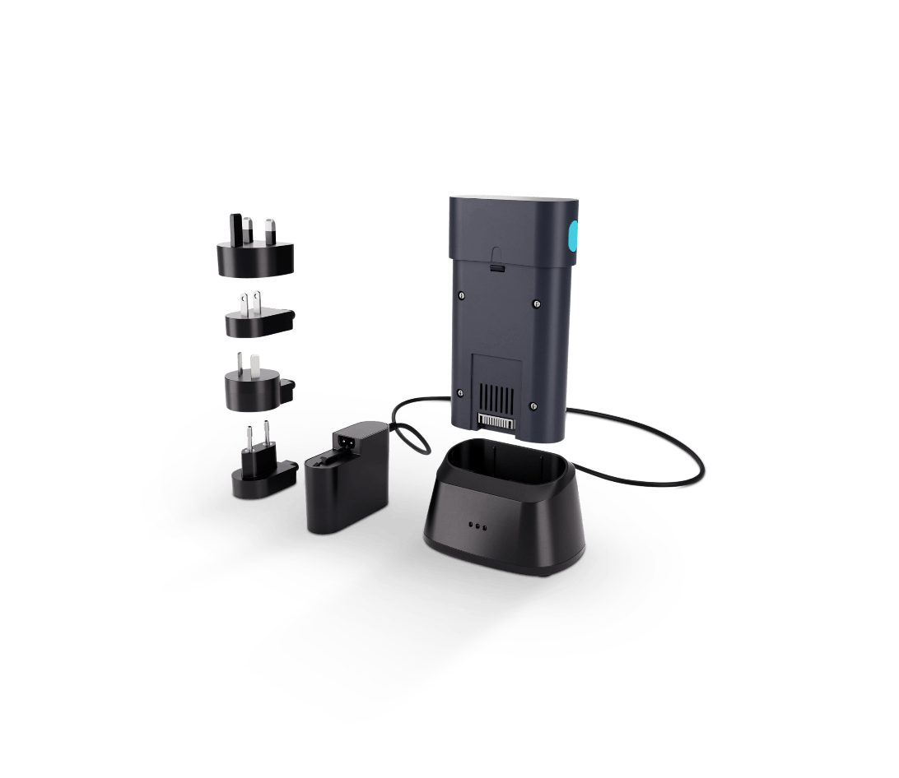
Product summary
Ergonomic handle
Mount on cleaning carts*
Highlighted touchpoints
Extended runtime with two batteries**
Advanced filtration
Intuitive controls
Easy manoeuvrability
No trip hazard
Versatile accessories
Quick recharge
*Requires specific dimensions
**Selected models

Slide 11



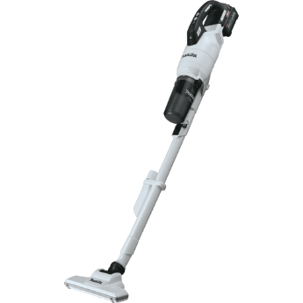
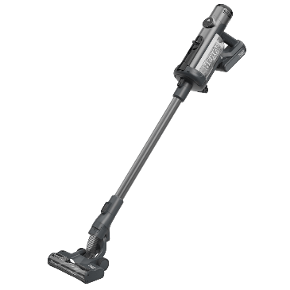


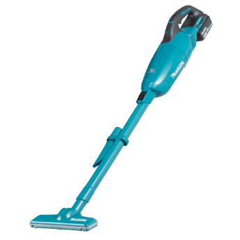
Competition
 | Unit | Nilfisk VU200 | Dyson V15 | Kärcher VC7 | Makita GLC03R1 | Numatic / Nacecare Henry Quick | Ryobi RSV18-0 | Stanley SFMCVS001D1-QW | Makita DCL280FZ
Filter type |  | HEPA 14 | HEPA 13 | EPA 12 | HEPA 13 | No | EPA 12 | No | No
Rated power | W | 550 | 545 | 350 | - | 300 | - | 350 | -
Airflow | l/sec. | 16 | - | - | 16,5 | 17 | 13,6 | 21 | 23
Dust bin capacity | l | 0,8 | 0,7 | 0,8 | 0,25 | 1 | 0,6 | 0,7 | 0,7
Battery charge time | min | 110 | 300 | 220 | 28 | 150 | 60 | 60 | 40
Battery run time | min | 60 | 60 | 60 | 80 | 60 | 22 | 60 | 33
Length x width x height | mm | 255x226x1255 | 266x250x1205 | 235x266x1130 | 228x203x1117 | 270x240x1220 | 275x222x1135 | 273x240x1168 | 155x113x1016
Weight | kg | 2,9 | 3,1 | 2,6 | 2,6 | 3,2 | 3,5 | 4,8 | 1,6
Price |  | €549 | €749 | €469 | €459 | €399 | €199 | €199 | €159

Slide 12
4
Customer benefits

Slide 13
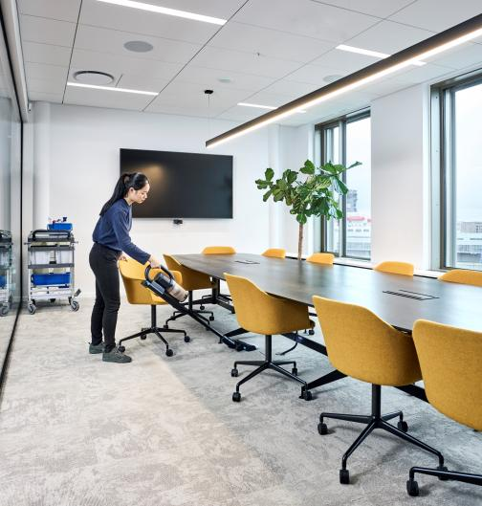
Customer benefits
Key selling points
Cordless convenience allows for time saving spot cleaning and eliminates cord trip hazards
Ergonomic handle allows for strainless cleaning
Intuitive use with highlighted touchpoints
Small and elegant dimensions allows for great manoeuvrability
Extensively tested for professional use
Certified HEPA filter for cleaner environment
Low weight, for easy portability and user friendliness
Mount on a cleaning trolley* for easy reach
High quality accessories, ensures good cleaning performance
Use together with the battery and charger kit for uninterrupted use
*Requires specific dimensions

Slide 14
5
Features

Slide 15
Features
Performance
Always within reach with the cleaning trolley mount*
Timesaving cordless design
6 different power setting to optimise performance on all floor types
Continuous cleaning with the charger and battery kit
High durability with professional certifications
The ergonomic handle, the compact size and the slim accessories allow to clean underneath fixtures, furniture, equipment etc.
Certified HEPA filter
Low charge time
*Requires specific dimensions

Slide 16
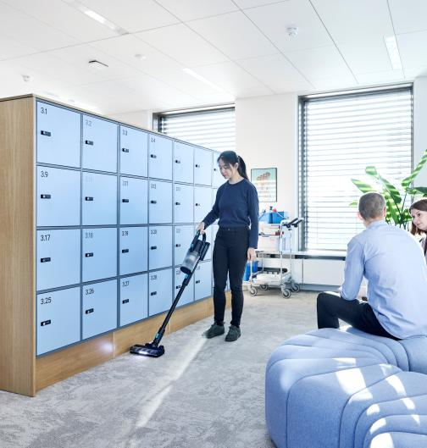
Features
Ease of use
Low weight for easy transport between locations
Ergonomic handle
Secure and easily mountable accessories
Empty dust bin with one push
Compact to store
HEPA 14 filter ensures anti-allergy exhaust air
Controls located on the handle for easy reach
Tool free service and replacement of all parts
Simply twist the top to change HEPA filter

Slide 17
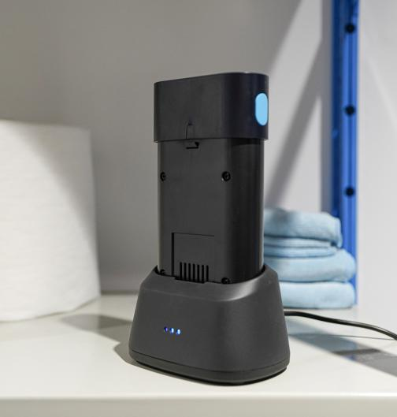
Features
Use with extra battery and charger
Continuous efficient cleaning with prolonged battery run time
Fast charging
Stay informed of battery level with the charging indicator
Small and compact charger

Slide 18
6
Durability testing

Slide 19
Durability testing
Standard test
VU200 test
Drop test
Drop the machine onto cement
floor 5 times
0,8 m
1 m
Staircase test
Drop down 13 concrete steps
3 times
3 times
Turn over test
Push the machine from an upright position
– repeat from all four sides
10 times – 40 times total
20 times – 80 times total
Mounting test
Add weight to the wall mount
2 times machine weight for 2 weeks
3 times machine weight for 2 weeks
Mount impact test
Mount machine in wall mount.
Impact of 5 km/h
N/A
80 times

Slide 20
7
Technical specification

Slide 21
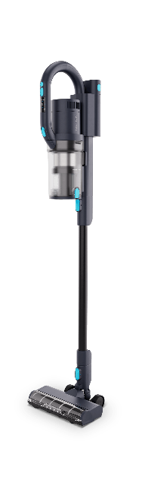


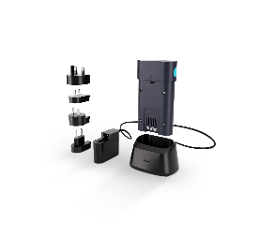
Technical specification
 | Unit | VU200 | Battery and charger VU200 | VU200 with battery and charger
Item no. |  | 128390174 | 128389489 | 128390175
Plug type |  | EU, UK, US, AU | EU, UK, US, AU | EU, UK, US, AU
Filter type |  | HEPA 14 | - | HEPA 14
Rated power | W | 550 | 66 | 550/66
Suction power end of tube | W | 170 | - | 170
Airflow | l/sec. | 16 | - | 16
Dust bin capacity | l | 0,8 | - | 0,8
Battery charge time | min | 110 | 110 | 110
Battery run time | min | 60/25/12 | - | 2 x 60/25/12
Length x width x height | mm | 255x226x1255 | 187x113x210 | 255x226x1255/187x113x210
Weight | kg | 2,97 | 1,4 | 2,97/1,4

Slide 22
Features
 | VU200 | Battery and charger VU200 | VU200 with battery and charger
Item no. | 128390174 | 128389489 | 128390175
Ergonomic design |  | - | 
HEPA filtration |  | - | 
2-in-1 |  | - | 
Multifunction hard and soft floors |  | - | 
Two speed |  | - | 
Wall mountable |  | - | 
Display on machine |  | - | 
Power connected indicator |  |  | 
Battery level indicator |  |  | 
Charging indicator |  |  | 

Slide 23
8
Accessories

Slide 24



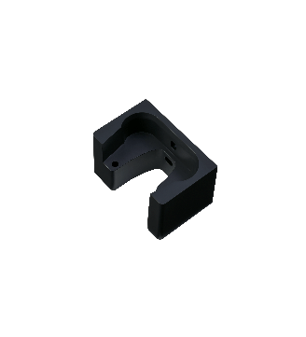




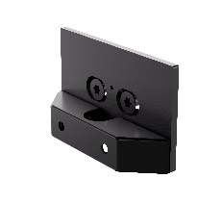
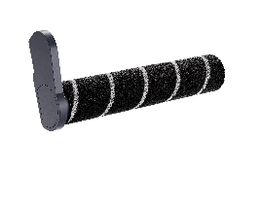

Accessories
 | Name | Item no.
 | Crevice tool S Black | 128389446
 | Combi brush S black | 128389448
 | Wall mount S black | 128389456
 | Sofa Brush S black | 128389450
 | Brush S black | 128389451
 | Hard floor roller VU200 | 128389496
 | Name | Item no.
 | Carpet roller VU200 | 128389497
 | Flexible hose S black | 128389452
 | Active brush S black | 128389454
 | HEPA 14 | 128389457
 | Hook and brackets | 128389500
 | VU200 | 128390174

