Slide 1
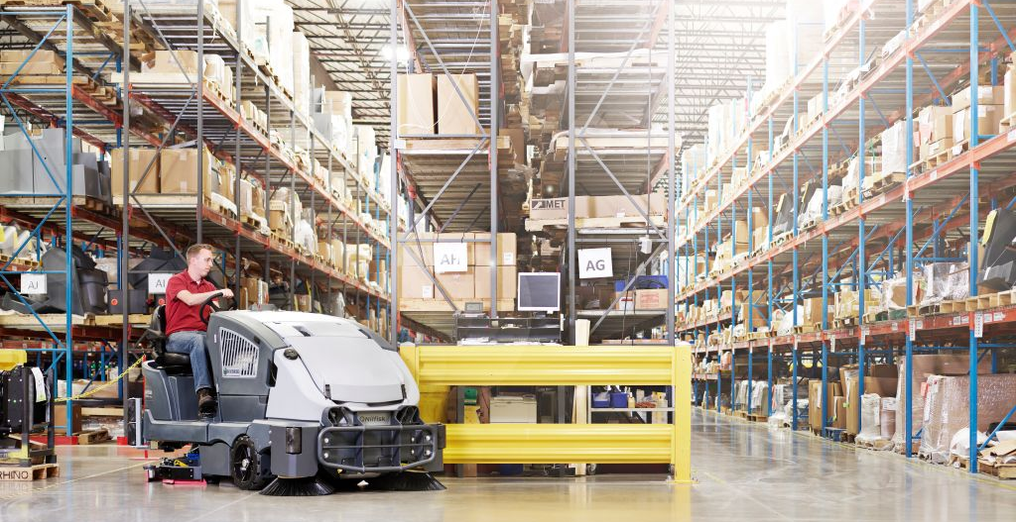
CS7010 Li-ion Battery

Slide 2
What Our Customers Tell Us
Long charge times limit
our productivity
Have to use ICE machine to
handle multiple shifts
We spend a lot of $ on battery replacement
over the machine life
Battery failures lead
to downtime
Forgot to charge batteries,
won’t finish
96% OF USERS SURVEYED EXPERIENCED AT LEAST ONE OF THESE ISSUES WITH TRADITIONAL LEAD ACID BATTERIES

Slide 3

Battery Positioning
CURRENT OFFERING
AVAILABLE NOW
When acquisition price tends to be
main driver
770Ah capacity (80% usable)
Routine battery watering required
18 Month Warranty
When productivity, warranty, fast charge and scalability are drivers
504Ah to 1008Ah (95% usable)
No Maintenance
5 Year Warranty
Fast & Opportunity Charge
Extended Run Time
Scalable
FAIR
BEST
FLOODED LEAD ACID
LITHIUM ION

Slide 4


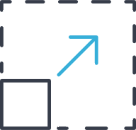
Why is Lithium Battery Attractive over Other Batteries
1
2
3
Multi-shift Productivity
Fast charge
Opportunity charge
Extended run time
Longest Warranty
5 year or 1500 cycles
Opportunity charge is a
partial cycle
Scalable
12 minimum modules
2 module incremental
24 maximum modules
Up to 55% more runtime over lead-acid on single charge

Slide 5
Multi-shift Productivity
____________________________
Get back to getting your job done faster
Fast charge up to 90% in 2.2 hours
Charge 3-4x faster than traditional battery
No cooling period needed
Get a quick boost during a short break
Opportunity charge if needed without battery damage
1 hour of total opportunity charge adds between 1.9 hours (entry package) to 3.8 hours (maxed out package) of runtime
Extend runtime to meet needs
You can get up to 55% machine runtime over current battery machine by adding modules
Customize the runtime (on single charge) from 4.2h to 8.4h in steps of 42 minutes
1

Slide 6

Confidence and Simplicity
____________________________
Rest easy knowing you’re covered
Longest warranty among battery options
5 years or 1500 cycles, non-pro-rated (whichever comes first)
Can fully charge/discharge battery 5 times/week for 5 years
Spend your time cleaning, not maintaining batteries
Modules require no maintenance
No expensive and complicated maintenance programs
Virtually eliminates dealer pain point with batteries
Keep dealers focused on growing Nilfisk, not battery failures
5 YEAR
WARRANTY
4

Slide 7

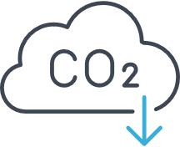
Why is Lithium Battery Attractive over Engine
1
2
3
Multi-shift Productivity
Fast charge
Opportunity charge
Extended run time
Better ROI
$5 saving on fuel per hour
of operation
Pays for itself in less than
3 years
Better for Planet
& People
No CO₂ or other GHG emission
Indoor air quality
Less noise

Slide 8
Multi-shift Productivity
____________________________
Get back to getting your job done faster
Fast charge up to 90% in 2.2 hours
Charge 3-4x faster than traditional battery
No cooling period needed
Get a quick boost during a short break
Opportunity charge if needed without battery damage
1 hour of total opportunity charge adds between 1.9 hours (entry package) to 3.8 hours (maxed out package) of runtime
Extend runtime to meet needs
You can get up to 55% machine runtime over current battery machine by adding modules
Customize the runtime (on single charge) from 4.2h to 8.4h in steps of 42 minutes
1

Slide 9
ROI
____________________________
Save $5 on fuel cost every operational hour
Exchange cost of $30 for standard 33lbs LPG tank
Electricity cost of $0.1 per kilowatt hour
Runtime of 5.5h with LPG tank and 5.5h with 16 modules
Payback in 2.7 years
Assuming 6 hours per day and 5 times a week use for 16 module machine
Reduced cost on maintenance and service
No oil or coolant change needed
Modules require no maintenance
No expensive and complicated maintenance programs
2

Slide 10
ROI
____________________________
Save 5.04€ on fuel cost every operational hour
Exchange cost of 25€ for standard 11kg LPG tank
Electricity cost of 0.21€ per kilowatt hour
Runtime of 5.5h with LPG tank and 5.5h with 16 modules
Payback in 2.7 years
Assuming 6 hours per day and 5 times a week use for 16 module machine
Reduced cost on maintenance and service
No oil or coolant change needed
Modules require no maintenance
No expensive and complicated maintenance programs
2

Slide 11
People and Planet
____________________________
No CO₂ or other GHG emission
Indoor air quality
Less noise
72dba on battery machine vs 82dba
on LPG machine
3

Slide 12
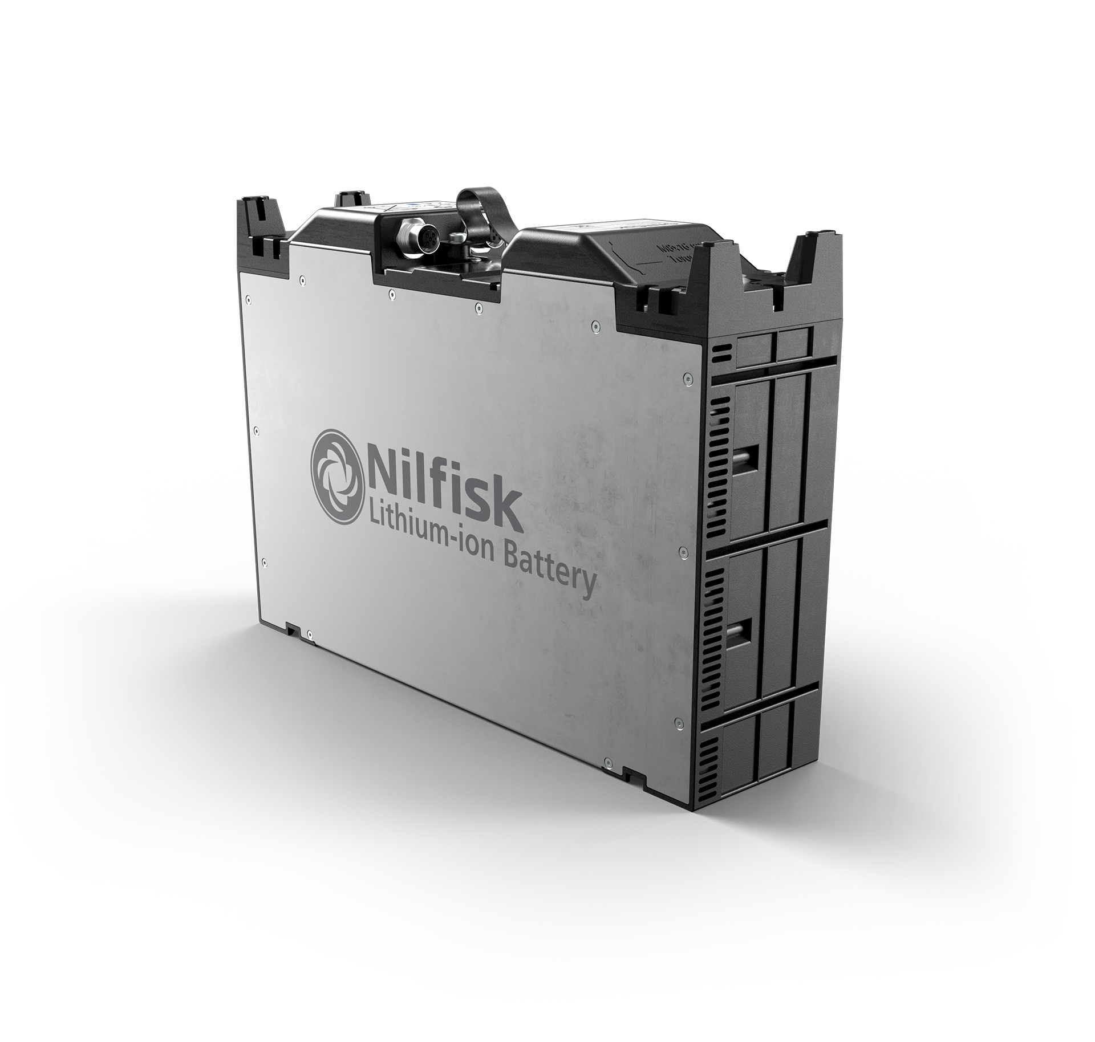
What is Unique About Nilfisk Lithium Offering?
Customize your power needs
Achieve specific runtime needs with scalability
Increase runtime by adding modules at any time
Maximize battery performance and value (future)
Save money by making data driven battery decisions
Connected smart battery enables analytics and diagnostics

Slide 13
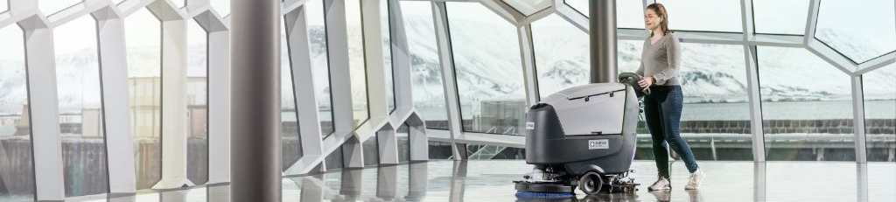
When Will Lithium Be Most Valuable?
1
2
3
4
Max Single Charge
Back to Back Shifts
Brief Yet Often
Continual
Unlock ability to clean during an entire shift
Get up to 8.5 hours of run time on CS7010 from a
single charge
Clean across multiple shifts with fast charge rates
Back to 90% charge in just over 2 hours with standard OBC
Get a quick boost during a break and get the job done
One hour of charge gets you between1.9 to 3.8 hours of run time without damaging the batteries
Conquer the most challenging continual cleaning demands
Clean for an entire shift and be fully charged for the next shift in as little as 2.5 hours

Slide 14
Single Cycle Usage Models – Productive vs Idle Time

Slide 15
Customer Usage Models – CS7010 Li-ion

Slide 16
Charge and Run Times for Li-ion
# Modules | Charge Times (in hours)
 | Lion 130 | Dual Lion 130
 | 300A | 600A
12 | 2.2 | 2.2
14 | 2.2 | 2.2
16 | 2.2 | 2.2
18 | 2.3 | 2.2
20 | 2.6 | 2.2
22 | 2.9 | 2.2
24 | 3.1 | 2.2
# Modules | Runtime (in hours)
12 | 4.2
14 | 4.9
Wet (770-800Ah) | 5.4
16 | 5.6
18 | 6.3
20 | 7.0
22 | 7.7
24 | 8.4
There is a limit how fast each module can be charged at. Once that limit is reached bigger charger isn’t going to charge it any faster than smaller ones.
Runtimes are for lower power settings.

Slide 17
The Li-ion Offering for EMEA
CS7010 Li-ion Machines
CM56511816-52 – CS7010 (EcoFlex, DG), 12 modules and no charger
CM56511816-53 – CS7010 (EcoFlex, DG), 12 modules and Lion 130 – ideal for single shift use
CM56511816-54 – CS7010 (EcoFlex, DG), 18 modules, 2nd battery box and 2X Lion 130 – ideal for multi-shift
CM56511816-55 – CS7010 (EcoFlex, DG), 14 modules and Lion 130 – ready to customize for runtime
Expansion Kits
56125002 – LI ION MODULE KIT-2X-CS7010 – 2 additional modules and cables
56125003 – LITHIUM ION EXP KIT-CS7010 – 2nd box is needed for more than 12 modules
56125163 – KIT-DUAL CHARGER-CS7010 – Enables dual charging on the machine side
106476029 – CHARGER 36V LI-ION EU 300A, 400-440V and 3 Phase
Field Retrofit Kits
56125206 LI ION RETROFIT KIT-CS7010 – Converts standard battery base (56511816) machine to lithium-ion ready base machine (56511825)
56125001 LITHIUM ION BASE KIT-CS7010 – All the cables, brackets and box needed for li-ion modules
106479001 BATTERY PACK, 36 VOLT, 10S14P –12 of these module is needed for the base machine
The above 3 items are all required for field retrofit, other items are listed under expansion kit.

Slide 18
CS7010 Li-ion Pricing for EMEA
Li-ion Machine Pricing
Description | P/N | List | D-Net
CS7010 (EcoFlex, DG), 12 Module, No Charger | CM56511816-52 | $TBD | $TBD
CS7010 (EcoFlex, DG), 12 Module, Lion 130 | CM56511816-53 | $TBD | $TBD
CS7010 (EcoFlex, DG), 14 Module, Lion 130 | CM56511816-55 | $TBD | $TBD
CS7010 (EcoFlex, DG), 18 Module, 2XLion 130 | CM56511816-54 | $TBD | $TBD
LI ION BASE KIT-CS7010 | 56125001 | $TBD | $TBD
LI ION RETROFIT KIT-CS7010 | 56125206 | $TBD | $TBD
LI ION MODULE KIT-2X-CS7010 | 56125002 | $TBD | $TBD
LITHIUM ION EXP KIT-CS7010 | 56125003 | $TBD | $TBD
KIT-DUAL CHARGER-CS7010 | 56125163 | $TBD | $TBD

