Slide 1
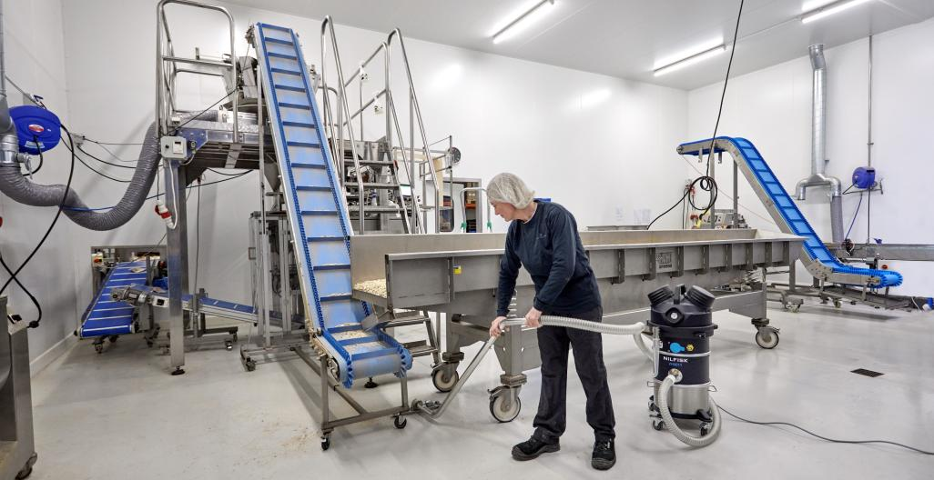
VHS010-VHS011
The mini industrial vacuums range

Slide 2
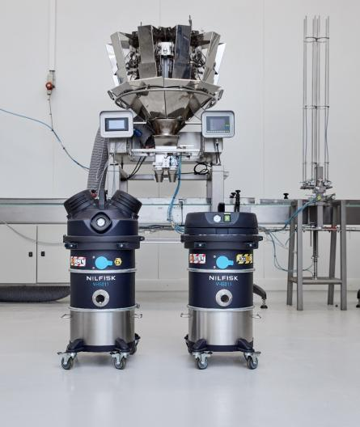
Agenda
1
Mini IVS range
and layouts
6
Pricing and positioning
2
Jobs to be done
7
Marketing material
3
Key features
and benefits
8
Technical specification
4
Accessories
9
Naming and hierarchy
5
Competitors
10
The corporate
responsibility

Slide 3
1
Mini IVS range and layouts

Slide 4
Mini IVS
Value proposition
Nilfisk VHS010-011 helps manufacturers protect their workers, eliminate safety risks and increase efficiency by providing a versatile range of affordable, high-performance compact industrial vacuum cleaners.
Protect workers and eliminate safety risks
Prioritizing workplace safety and workers health.
Increase efficiency
Focus on the main value we offer to our customers.
Versatile
The small size and the 4 distinct models are designed to meet the needs of our customers.
Affordable
Excellent value for investment, long lifetime even in tough production environments.
High-performance and compact
Underlining the combination between being very small but providing the high performance needed in industrial environments.

Slide 5
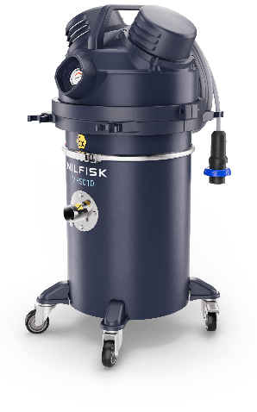
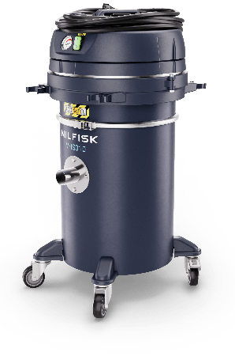
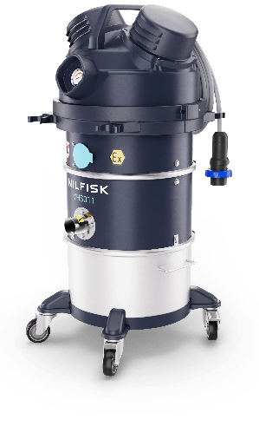
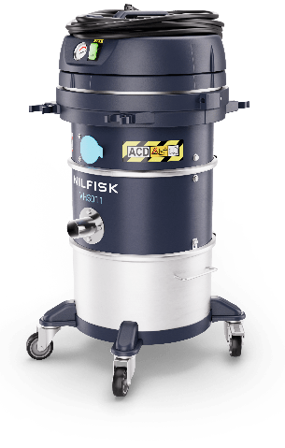
Mini IVS
Range introduction
Introduction
Mini-IVS is a platform of industrial vacuum cleaner of small and compact footprint. The range is designed for industrial application as alternative solution to the 400 mm platform, bigger machine VHS110 and VHS120, models single phase 1 motor and 2 motors.
Designed for dry collection of powders and fine powders or grains, combustible and or conductive and hazardous dusts.
Range key feature:
One layout with safe disposal – body 010;
One layout with pull clean filter cleaning system without needs of consumable – body 011
Lightweight and robust, perfect solution for fast and frequent cleaning job also in narrow spaces or when the are obstacles on the floors or difficult places to reach
New dedicated range of industrial reduced footprint accessories, EXA and ACD
MEET NILFISK’S MINI INDUSTRIAL VACUUMS
Small but mighty.
Maximum performance, safety, and flexibility. Minimum footprint.

Slide 6


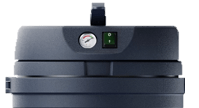
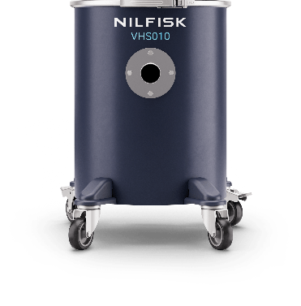


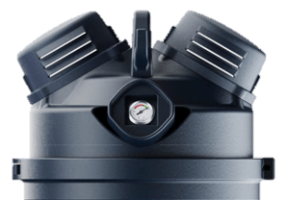
Mini IVS
Layout
IP44
Safe disposal
4 models available
Container, 30L
Configuration: bag filter + safety filter H14
Suitable for combustible dust and ATEX
Suitable for hazardous dusts L or H
VHS010 HC ACD
VHS010 LC ACD
Body VHS010
IP65
VHS010 HC Z22 EXA
VHS010 LC Z22 EXA

Slide 7

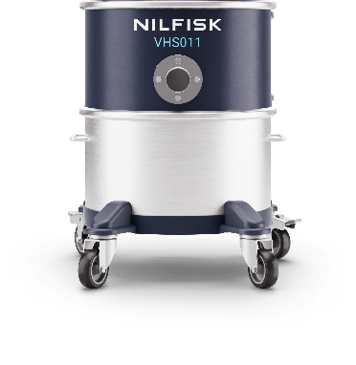


Mini IVS
Layout
Pull&Clean
2 models available
Container 15 L with removable whee-lbase
Optional Upstream HEPA14 filter (US included)
Suitable for combustible dust and ATEX
Suitable for hazardous dust L
IP44
VHS011 LC ACD
Body VHS011
IP65
VHS011 LC Z22 EXA

Slide 8
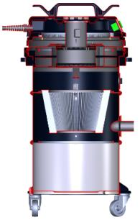

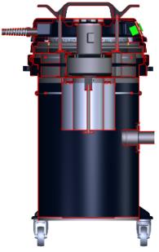

Product definition
Section view: flow schematic and architecture ACD models
VHS011 LC ACD
With conical cartridge Class M and Pull&Clean
VHS010 LC ACD
Safe disposal with:
Class M antistatic
fleece filter
VHS010 HC ACD
Safe disposal with:
Safe bag system
Process air
Cooling air

Slide 9
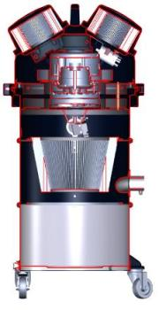
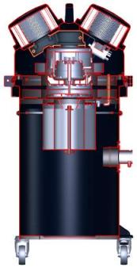
Product definition
Section view: flow schematic and architecture ACD models
VHS011 LC Z22 EXA
With conical cartridge
Class M and Pull&Clean
VHS010 LC Z22 EXA
Safe disposal with:
Class M antistatic
fleece filter
VHS010 HC Z22 EXA
Safe disposal with:
Safe bag system
Process air
Cooling air

Slide 10
2
Primary application and use

Slide 11
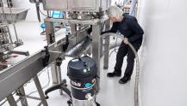
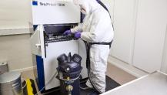
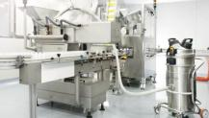
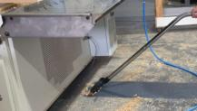
Key features and benefits
Typical cleaning job:
  Cleaning packaging machine or process equipment as conveyor belts, mixer, mill etc.
  Cleaning of floors, desks, surfaces
Key features:
  For Z22 Atex zones and for combustible dusts
  Long life filter and no consumables
  Washable container
  Food colored accessories
Typical cleaning job:
  Collection and cleaning metal 3D printers, glove box, finished parts, emptying bins…
Key features:
  Certified for conductive combustible dust, safe with IP65 enclosure
  Safe bag system disposal and H CLASS certified
Typical cleaning job:
  Cleaning pharmaceutical process machines or process equipment
  Cleaning of floors, desks, surfaces in production area
Key features:
  Fully Stainless-steel body
  HEPA14 filtration
  Not contaminating working environment
Typical cleaning job:
  Collection of dust and wood chips from automatic machines and equipment
  Cleaning of floors, desks, surfaces
Key features:
  Suitable for hazardous and combustible dusts, as ex painted wood dust or very fine dusts
Food Industry
Primary and secondary packaging
AM industry*
Production line, part of the process
Pharma industry
Primary and secondary packaging
Generic manufacturing
Textile, Wood, Painting, furniture
* Not for north America

Slide 12

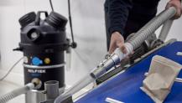
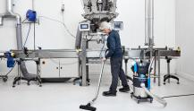
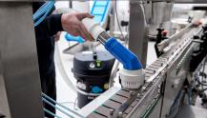
Food industry application focus
Jobs to be done / relevant areas
Final product packed in direct contact with its packaging
Job-To-Be-Done for VHS011 LC Z22: floor cleaning
Final product packed in direct contact with its packaging
Job-To-Be-Done for VHS011 LC Z22: cleaning packaging lines in narrow spaces
cleaning of conveyor belts and packaging machine
Final product packed in direct contact with its packaging
Job-To-Be-Done for VHS011 LC ACD: floor cleaning
Final product packed in direct contact with its packaging
Job-To-Be-Done for VHS011 LC ACD: cleaning packaging lines in narrow spaces
cleaning of conveyor belts and packaging machine
 Primary packaging
classified zone
 Primary packaging
 Primary packaging
 Primary packaging
not classified zone
Classified zone
Classified zone
Combustible dust
Combustible dust

Slide 13
3
Key features and benefits

Slide 14
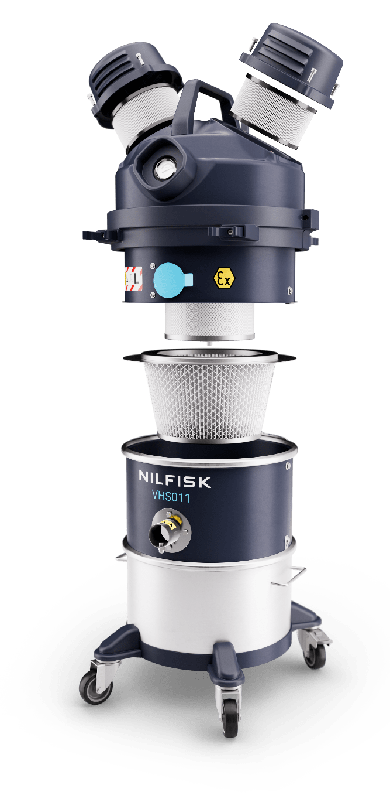
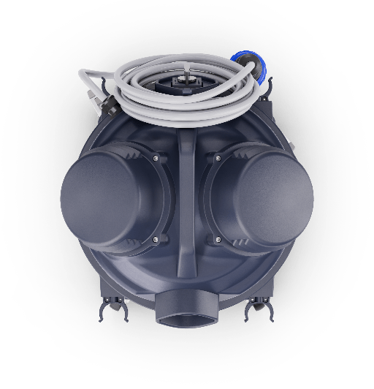
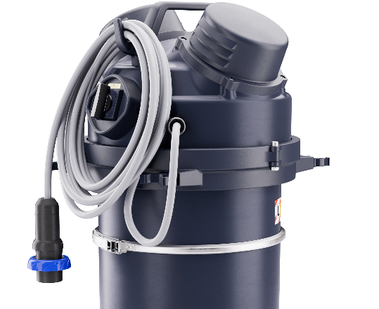

Key features and design
Handle and power cord holder
VHS011 Z22 EXA / C2D2
Power cord
9 meters
Plug
2P+T
Vacuum gauge for a constant monitoring of the performance and filtration efficiency
Free dust motor enclosure with a protection rate IP65
Rounded shape for an easy cleaning of the overall surface
PullClean cleaning filter system, easy and efficient operation
Quiet – only 72 dB(A) level noise
High efficiency filters: M-Class (as standard);
PTFE or HEPA 14 upstream filter 99,995% 0.1 - 0.2 microns (as option) all filters are antistatic
Easy and fast service: everything quickly accessible
Accessories holder
Fully grounded and bonded, avoids electrostatic sparks, electrical hazard
Safe and mistake proof connection for certified ATEX accessories Ø40 EXA
Main switch ATEX
15 L removable container AISI304, easily washable thanks to removable wheel-base
Parking brake, stable also on slightly sloped
Cable gland ATEX
High maneuverability thanks to
the 4 ball bearing pivoting wheels
Brushless motor
up to 10.000 hours
Antistatic wheels

Slide 15
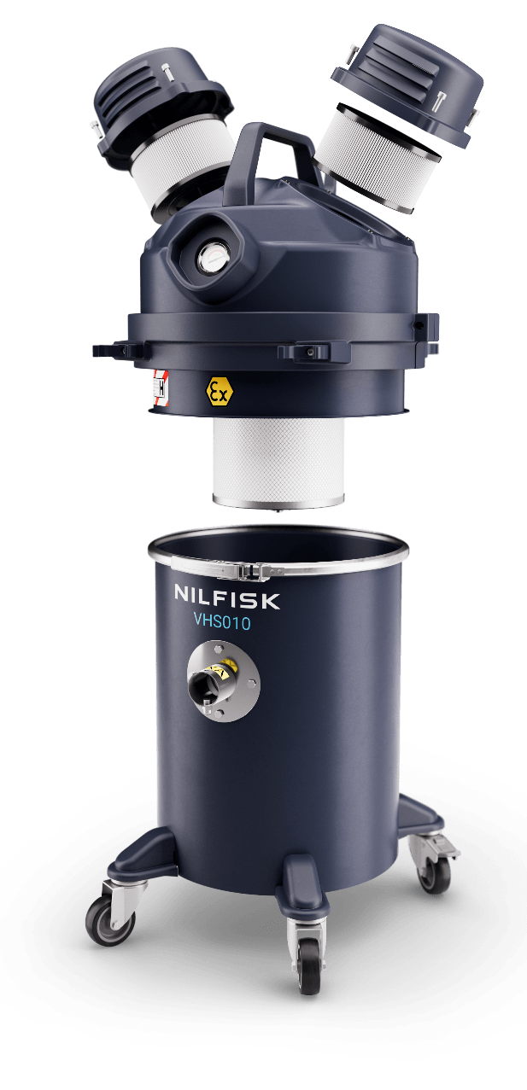

Key features and design
Handle and power cord holder
VHS010 Z22 EXA / C2D2
Power cord
9 meters
Plug
2P+T
Vacuum gauge for a constant monitoring of the performance and filtration efficiency
Free dust motor enclosure with a protection rate IP65
HEPA 14 safety filter efficiency 99,995% 0.1 - 0.2 microns
Rounded shape for an easy cleaning of the overall surface
30 L externally painted AISI 304 container
Quiet – only 72 dB(A) level noise
Safe and mistake proof connection for certified ATEX accessories Ø40
Accessories holder
Fully grounded and bonded, avoids electrostatic sparks, electrical hazard
Convenient and safe disposal system
Main switch ATEX
Parking brake , stable also on slightly sloped
Cable gland ATEX
Antistatic wheels
High maneuverability, container
with 4 ball bearing pivoting wheels
Brushless motor
up to 10.000 hours

Slide 16
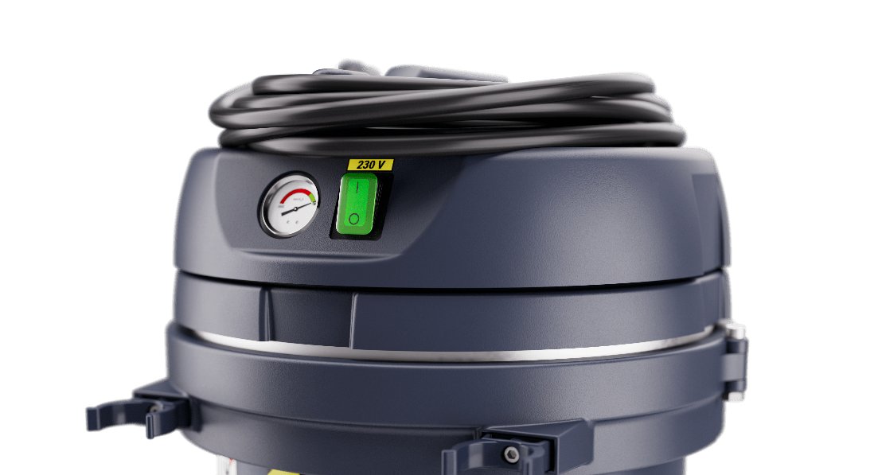

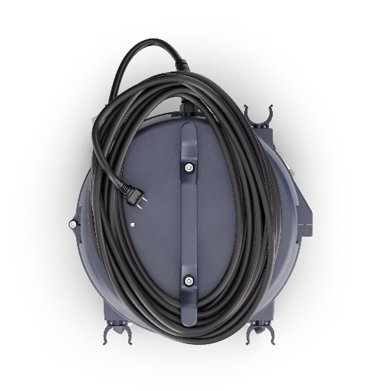

Key features and design ACD models
VHS011 LC ACD VHS010 LC/HC ACD
3
4
1
2
Handle and power cord holder
Power cord
9 meters
ACD motor head has some difference from the Z22 / C2D2 versions.
All other parts not described in this ACD deep dive are the same
of Z22 / C2D2 variants
Schuko plug (EU)
1 | Vacuum gauge for a constant monitoring of the performance and filtration efficiency
2 | Standard main switch with green light
3 | Quiet – only 70 dB(A) level noise
4 | Light weight conductive plastic motor-head enclosure with a protection rate IP44
Accessories holder
Standard inlet

Slide 17
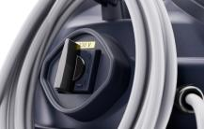
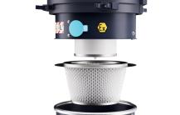
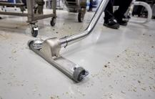
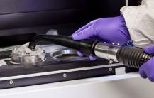
Key features and benefits
Electrical component externally installed, third party certified – means highest level of safety for operators and business ‘s protection against useless risks.
Primary filter M Class – optimal filtration of fine dusts; safe bag system protects operators' exposure.
HEPA14 Filtration – arrests 99,995% of particles, size range 0.1 - 0.2 µ m.
Accessories storage solution on machine – space to store essential accessories required for the task.
Long life components – cartridge filters build with metal housing, use best materials.
Low TCO – PullClean filter cleaning system perfectly keep efficient the filtration, less downtime and less maintenance.
Reduced dimension and weight accessories where possible – e.g. floor nozzle reduced to 300 mm as the handgrip ,now also in two pieces.
Incredibly maneuverable – wheel-base and low weight makes the IVAC easy to move and control also in tight spaces.
Fit for purpose long life components – brushless motor ensure incredible long-life, up to 10.000 hours;
1 motors 950W achieve required suction power – even with heaviest dust s like metal dusts, the collection is efficient and fast.
Safety
Electrical components – Filtration – Operator protection
Productivity
Everything designed for longer lifetime
Comfort
Increasing comfort to improve productivity
Performance
Having the power to achieve
specific tasks

Slide 18
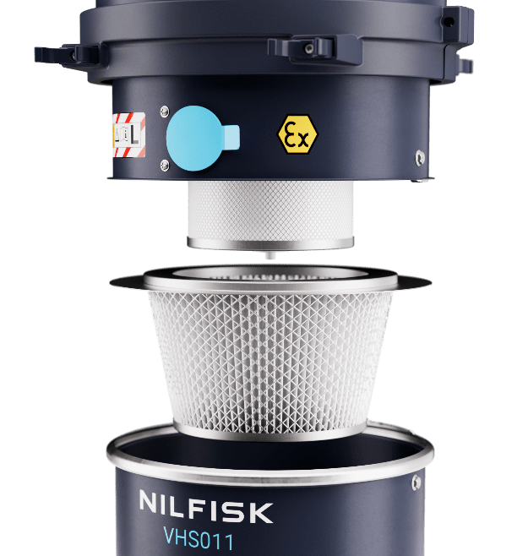

PullClean
L Class VHS011…
Efficient filter cleaning
Description
Pull clean filter cleaning system is a manual system with which operator can easily clean the filter and keep high the efficiency of the vacuum cleaner.
How it works
The cleaning of the filter is done with the inlet of the machine closed.
Three rapid opening and closing of the blue flap create a counter impulsive flow into the filter that is in this way cleaned.
Rapidly repeat the cleaning process for three times for the perfect cleaning of the filter
Value and benefit
Reduced maintenance
Stable performance make faster the cleaning job
Safe method of clean the filter without stop the suction

Slide 19
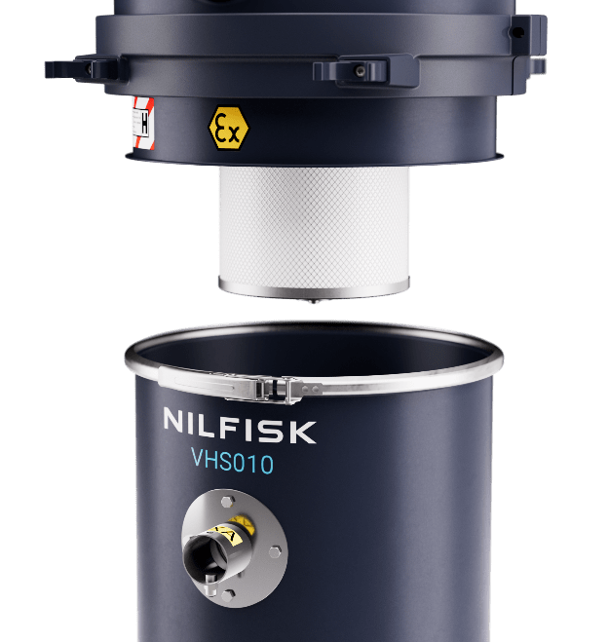

Safe bag system
No dust exposure
H Class VHS010….
Description
HCLASS certified models are quipped with the safe bag system; this disposal system allow to dispose the collected material without being in contact with the material itself.
How it works
It is built with a CLASS M fleece filter and a special bag inlet with safety guillotine valve, externally protected by a conductive and resistant plastic bag.
The bag filter safely collect the material, external plastic bag protects operator from the contact with the filtering bag during the disposal procedure.
The guillotine valve, when manually closed, avoid any leakage of dust from the inlet of the safe bag system
Value and benefit
Perfect protection accordingly different types of hazardous dusts
Secondary protection with HEPA14 certified filter
Safe, easy and quick disposal system

Slide 20
4
Accessories

Slide 21
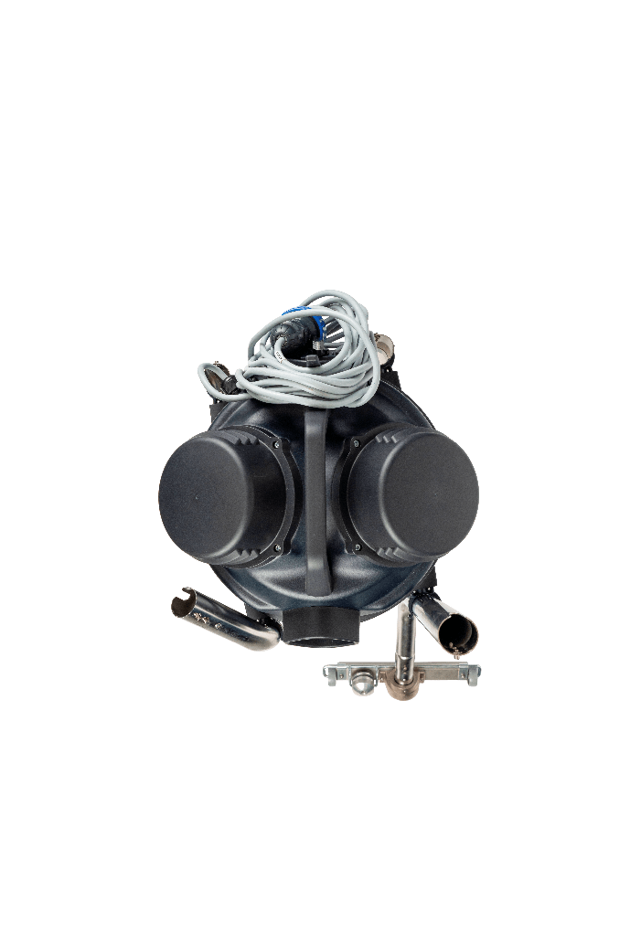
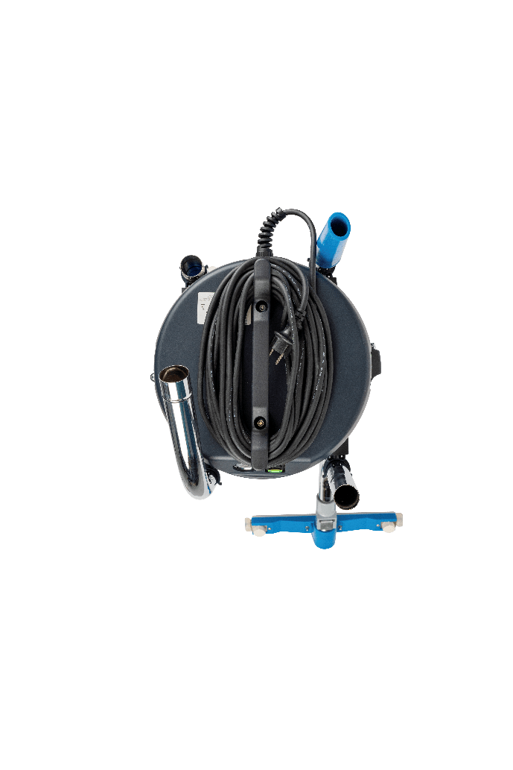
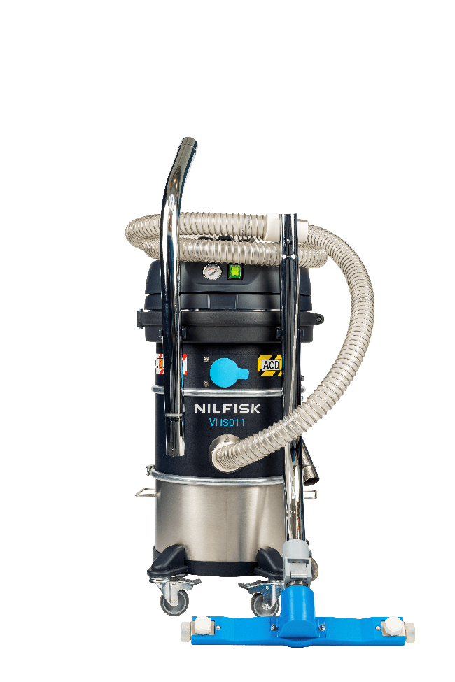
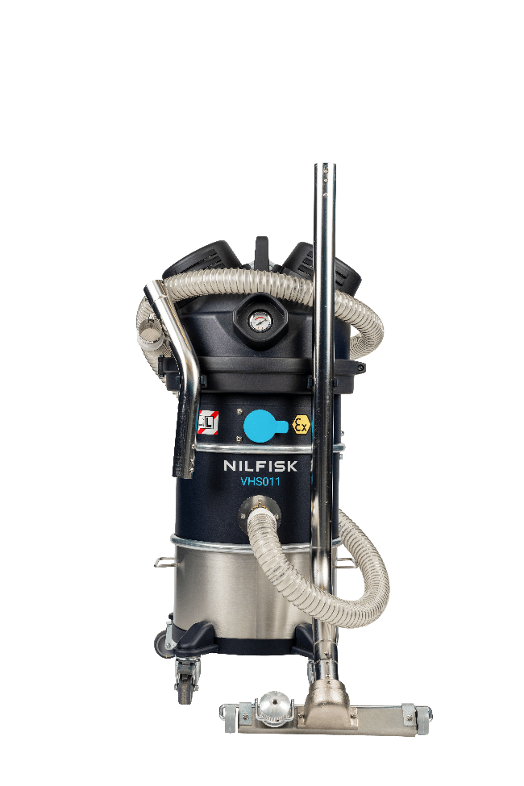
Accessory holder
Parking position
Description
Four convenient and robust clips, two each side, useful to easily transport up to 4 end tools
How it works
When IVAC is parked, the accessories holder can easily keep the new small handgrip and floor nozzle
Disconnect hose from IVAC’s inlet and handgrip for an easiest positioning
Disconnect bulky accessories, as handgrip and floor nozzle, before moving the machines
Value and benefit
Accessories always nearby
Parking with minimum space occupation

Slide 22













Mini IVS Z22
EXA connection with PIN
EXA Ø40 mm accessories
EXA antistatic hose 3 m
EXA bent connection
EXA conductive cone
EXA antistatic hose 3 m polyurethan FDA
EXA bent connection AISI 304
EXA antistatic cone silicon transparent
EXA flat lance AISI 304 300 mm NEW
EXA silicon nozzle with D40-32 reduction
EXA antistatic hose 3 m,
EXA bent connection AISI 304
EXA AISI 304 antistatic cone
EXA AISI 304 flat lance 300 mm NEW
EXA AISI 304 antistatic round brush
EXA small handgrip (for bent connection) NEW
EXA AISI 304 mobile floor nozzle
300 mm NEW
EXA antistatic hose 3 m FDA,
EXA bent connection AISI 304
EXA conductive cone black
EXA flat lance AISI 304 300 mm NEW
EXA conductive nozzle Ø 40-32
Basic Ø40 mm EXA (available also in combo version: CB)
4072400773
Machineries FDA Ø40 mm EXA
(complete) Ø40 mm
4072400822
General cleaning Ø40 mm
EXA
4072400824
Machineries conductive
Ø40 mm EXA (complete)
Ø40 mm
4072400823
2
2
4
2
7
5
5
2
4
4
5
6
3
1
1
3
1
3
1
3

Slide 23






Mini IVS ACD and CIID2
ACD sleeve connection
ACD Ø40 mm accessories kits
Flex conductive hose 3 m + sleeves
AISI304 bent connection
Conductive cone
Basic ANTIST. Kit ACD Ø40
4072400825
Flex conductive hose 3 m + sleeves
AISI304 bent connection
Conductive cone
AISI 304 flat lance 300 mm NEW
Antistatic floor nozzle 300 mm NEW
AISI 304 small handgrip 2 parts NEW
Round antistatic brush
General kit ACD Ø40
4072400774
Antistatic FDA transparent hose 3 m + sleeves,
AISI 304 bent connection
Silicone Antistatic FDA Cone
Flat lance AISI 300 mm NEW
Reducer Ø40/Ø32 SS
Flexible nozzle autoclavable Ø32
AISI 304 flat lance (300 mm)
Machineries FDA ACD kit Ø40
4072400826
2
5
2
6
5
6
3
3
2
1
1
3
1
4
7
4

Slide 24

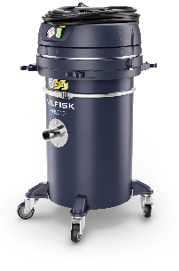







Mini IVS machine and accessories – suggested choice I
Food
Cleaning packaging machines
Metal & additive manufacturing
Cleaning 3D printers
General industry*
General cleaning solution
VHS011 LC Z22 EXA
4010100113
VHS011 LC Z22 EXA
4010100113
VHS010 MC ACD
TBD**
Hygienic container
Without consumable
FDA end tools and hoses
Hygienic container
Not contaminating env.
Safe with conductive dusts
Affordable safe disposal
Light weight
Multipurpose premium IVAC
Accessories KIT FDA Machine EXA
4072400822
Accessories KIT Machine EXA
4072400823
Accessories KIT General ACD
4072400774
VHS011 LC ACD
4010100120
VHS010 MC Z22 EXA
TBD**
VHS010 MC Z22 EXA
TBD**
Hygienic container
Without consumable
FDA end tools and hoses
Safe dispose
Not contaminating env.
Safe with conductive materials
Affordable safe disposal
Light weight
Multipurpose premium Z22 IVAC
Accessories KIT FDA Machine ACD
4072400826
Accessories KIT Machine EXA
4072400823
Accessories KIT General EXA
4072400773
**From 09/2024
*wood, painting and many others

Slide 25
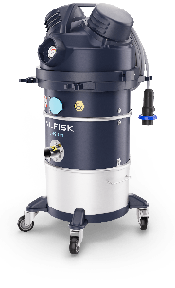

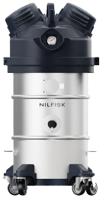



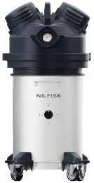
Mini IVS machine and accessories – suggested choice II
Electronics
Cleaning production machineries
Carpentry, mechanical workshop
Starter kit for general entry level application
Pharma and nutraceutical
Cleaning packaging machines
VHS011 LC Z22 EXA
4010100113
VHS010 LC ACD
4010100122
VHS011 LC Z22 EXA 3X AU
TBD**
High cleanability
Not contaminating env.
Safe with conductive materials
The most robust, compact and lightest industrial vac, with affordable, scalable, safe disposal options
High cleanability
Not contaminating env.
FDA end tools and hoses
Accessories KIT Machine EXA
4072400823
Accessories KIT Basic ACD
4072400825
Accessories KIT FDA Machine EXA
4072400822
VHS010 HC Z22 EXA
4010100116
VHS011 LC ACD
4010100120
VHS010 HC Z22 EXA 3X
TBD**
Safe dispose
Not contaminating env.
Safe with conductive materials
The most robust, compact and lightest industrial vac, with high performance filtration without consumable for high powder load
Safe disposal
Not contaminating env.
FDA end tools and hoses
Accessories KIT Machine EXA
4072400823
Accessories KIT Basic ACD
4072400825
Accessories KIT FDA Machie ACD
4072400822

Slide 26


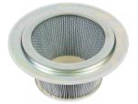

Spare filters for VH011...
VHS011 LC Z22 EXA / C2D2 and VHS011 LC ACD
HEPA14 spare filter: Z8 17262
Primary Filter Cat. M: 4081701855
Primary Filter Cat. M PTFE: 4081701856
Z8 17262*
4081701855*
* Refer to user manual and spare part list for maintenance and spare kits

Slide 27





Spare filters and bags filters for VHS010...
VHS010 LC Z22 EXA / C2D2, VHS010 HC Z22 EXA / C2D2 and VHS010 LC ACD
HEPA14 spare filter: Z8 17262
5 PC fleece filter: 107419592
1 PC safe bag system: 4084001573
107419592
4084001573
Z8 17262*
* Refer to user manual and spare part list for maintenance and spare kits

Slide 28
5
Competitors

Slide 29
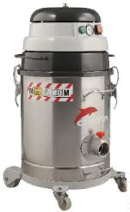
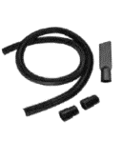
Z22 competitor analysis: Delfin
Standard
Positive
Negative
Primary additive manufacturing, secondary industry food
Self declared ATEX Z22
Competitor main features
1.1 KW Motor in a medium small footprint IVAC with limited overall dimensions (215* m³/h)
Filter clogging control vacuum meter, no filter cleaning system
40 liters container (gross), AISI 304
Star filter 0,4 m², upstream filter optional, downstream filter standard, good filtration
Disposal with bag filter
Dimension 440x420x780, weight 25 Kg
74 dB (noisy)
Self declared Z22 and MCLASS and HCLASS
Good cleanability (metal moto-head)
Only dry material
No accessory holder
Poor maneuverability
Detachable trolley
Industrial
vac
Incluso
Atex starter KIT Ø40
P13641
Delfin MTL 300 1/3D BL
*probably declared motor max airflow

Slide 30

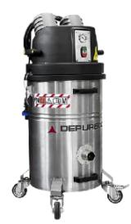
Z22 competitor: Depureco
Standard
Positive
Negative
Primary additive manufacturing, secondary industry food
Self declared ATEX Z22
Competitor main features
1.1 KW Motor in a medium-small footprint IVAC max airflow 220* m³/h max vacuum 230 mbar
Filter clogging control vacuum meter
45 liters container (gross), AISI 304
Star filter 0,6 m², upstream H14 filter optional, downstream filter E10 colling filters
Disposal with bag filter
Dimension 516 x 545 x 1050, weight 38 Kg
72 dB (standard noisy)
Self declared Z22 and MCLASS
Medium cleanability
Only dry material
No accessory holder
Industrial
vac
DEPURECO BL PRO ATEX Z22
*probably declared motor max airflow

Slide 31

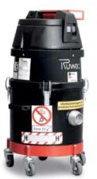
Z22 competitor: Ruwac
Standard
Positive
Negative
No ATEX but TYPE 22
Competitor main features
1,2 KW powerful motor (200* m³/h) in a medium
footprint with quite limited overall dimensions
Filter clogging control (vacuum meter), No filter cleaning system
16 liters container (gross)
Upstream and downstream HEPA 14 filters,
M class primary filter
Disposal with bag filter
Dimension 425x425x800 mm, weight 35 Kg
70 dB (silent)
Self declared (TYPE22) and HCLASS
Standard power socket
Poor cleanability – plastic motorhead (Conductive Plastic)
No accessory holder
Dry
Industrial IVAC
Industrial
vac
RUWAC R18 H ZONE 22
*probably declared motor max airflow

Slide 32
Z22 competitor: Kerstar
Standard
Positive
Negative
Primary food, secondary additive manufacturing
No ATEX but TYPE 22
Competitor main features
1 Kw powerful motor 210* m³/h medium footprint IVAC equipped with two different trolleys and containers
No filter cleaning system
20-30 liters container, AISI 430 mirror polished
Big filtering surface, but no data, as for the upstream filter HEPA14
Dimension 440x440x830 – 460x500x1080,
weight 21,2 – 26,8 Kg
74 dB (noisy)
Self declared Z22 and HCLASS
Only dry material
Not efficient disposal system for a marked
H-Class machine
Medium cleanability
KEVA 30H
Industrial
vac
KEVA 20H
KERSTAR
*probably declared motor max airflow

Slide 33
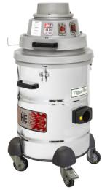
Z22 competitor analysis: TIGER-VAC
Standard
Positive
Negative
Primary segment B&C, secondary industry manufacturing
Competitor main features
1.2 KW Powerful in a medium small footprint IVAC with limited overall dimensions
Filter clogging control, no filter cleaning system
19 liters container, painted or AISI 304 mirror polished
Very good filtration, up to 4 stages, primary filter 0,34 m², upstream filter 2 m²
Disposal with bag filter 0,8 m²
Dimension 480x460x890, weight 28 Kg
72 dB (standard noisy)
Certified Z22 C2D2 and HCLASS
Only dry material
No accessory holder
Industrial
vac
TIGER-VAC C10-EX

Slide 34
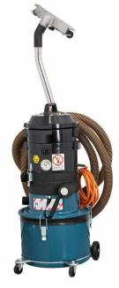
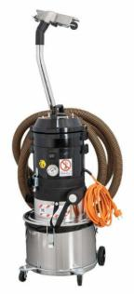
Z22 competitor analysis: Dustcontrol
Standard
Positive
Negative
Primary segment B&C, secondary industry manufacturing
Industrial
vac
ATEX Z22 self declared
Competitor main features
1.5 Kw powerful for 170 m³/h in a small footprint IVAC with limited overall dimensions
Filter clogging control vacuum meter, Pull&Clean system
20 liters container (gross), painted stainless steel AISI430 optional AISI 304
Wide filter, 1,5 m² and HEPA H13 0,82 m²
Dimension 400x400x840, weight 16.5 Kg
Self declared Z22 and Certified HCLASS
70 dB (silent)
Easy and fast access to filters (high serviceability)
No conductive dust
Poor cleanability (not relevant for focus segment)
Accessory holder
DC 1800 H EX
DC 1800 H EX stainless steel

Slide 35
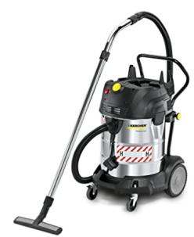
Z22 competitor: Karcher
Standard
Positive
Negative
Primary light B&C, secondary industry manufacturing
No ATEX but TYPE 22
Competitor main features
1 KW powerful motor 216* m³/h in a medium footprint with quite limited overall dimensions
Filter clogging control, No filter cleaning system
75 liters container (gross), AISI 430
Upstream and downstream HEPA 13 filters
Disposal with bag filter
Dimension 640x540x925, weight 27,8 Kg
76 dB (noisy)
Self declared Z22 and HCLASS
Poor cleanability – plastic motorhead
Accessories holder included
Wet & Dry
Professional vac
Karcher NT 75/1 Me EC H Z22

Slide 36

Z22 competitor analysis: Nilfisk blue
Standard
Positive
Negative
Primary light B&C, secondary industry manufacturing
No ATEX but TYPE 22
Competitor main features
1 KW Motor 192* m³/h a medium footprint with quite limited overall dimensions
Push Cleaning system and filter clogging control
37 liters container, AISI 430
Upstream and downstream HEPA filters, small downstream filter
Disposal with bag filter good performance and capacity
Dimension 440x450x735, weight 13 Kg
60 dB (very silent)
Self-declared Z22 and HCLASS
Poor cleanability – plastic motorhead
Wet & Dry
Poor maneuverability
Professional vac
Nilfisk ATTIX 40M PC Type 22
*probably declared motor max airflow

Slide 37
6
Pricing and positioning

Slide 38









Overall list price*
Positioning in Nilfisk portfolio – Germany
+33%
ATTIX 40-0M
PC Type 22
S3 LC ACD
+38%
3.507 €
3.550 €
+36%
VHS120 LC ACD
VHS010 LC ACD
2.630 €
1.400 €
VHS011 LC ACD
1.900 €
Gross list price* €
Single-phase
2450 €
3.450 €
VHS011 LC
Z22 EXA
4.643 €
VHS010 LC
Z22 EXA
VHS110 Z22 EXA
+28%
+35%
*List price Germany 2023

Slide 39








List price*
Positioning vs main competitor
NT75/1 MeEc H Z22
KEVA 45H
Self-certified
3.300€
ATTIX 4-0M PC
Type 22
3.149 €
KERSTAR
KEVA 20H
3.550 € DE
2.700€
MTL 300
1/3D BL
MTL451BL
(H opt.)
IVM40/12-1(H)Z22
2.487 €
3.440 €
3.550 € DE
(MC mandatory)
Gross list price* €
Single-phase
Third party certified
1.400 €
1.900 €
2.450 €
3.450 €
4.643€
VHS010 LC ACD
VHS011 LC ACD
VHS010 LC Z22 EXA
VHS011 LC Z22 EXA
VHS110 Z22 EXA
*List price Germany 2023

Slide 40
7
Marketing material

Slide 41

Messaging
Primary messaging
Key message
Meet Nilfisk’s mini industrial vacuums
Small but mighty.
Maximum performance, safety, and flexibility. Minimum footprint.
Value proposition
Nilfisk VHS010-011 helps manufacturers protect their workers, eliminate safety risks and increase efficiency by providing a versatile range of affordable, high-performance compact industrial vacuum cleaners.

Slide 42
A full set of assets which covers internal and external needs
Product renderings
Location pictures
Sales and promo video
Brochure
Fact sheet
Quick start guides video
External presentation
Internal presentation
Recommended part list
User manual
Main data file
10x Social media posts
(8 video posts (LI/FB) + 2x non-video posts focusing on downloading the PDF (FB))
3x emails for EC
1x pdf for AE
1x Teaser PDF
1x Pardot LP for AE download
1x Pardot LP for product information including SSE form
Email signature banner
1x tile for Umbraco homepage
2x emails to dealers for downloading the dealers package
Product renderings
Location pictures
Sales and promo video
Brochure
Fact sheet
Use and Care video
External presentation
Email template
2x Some template
Web-banner template
Recommended part list
User manual
Main data file
Basic introkit
Nilfisk to end customers
Nilfisk to dealers
Dealers to their customers
(Dealer package)

Slide 43
Timeline
27/29 of February
(W9)
29 of March
(W13)
3 of April
(W14)
10 of May
(W19)
21 of May
(W21)
04 of June
(W23)
18 of June
(W25)
Shooting
Global masters release
Kick off meeting with EMEA FM
Sales release
Internal Launch
EMEA / Americas
Channel Launch
EMEA / Americas
Market launch (Campaign go-live)
EMEA / Americas
Internal launch
Introduction to the customer care and service teams
Introduction to the sales team
Channel launch:
Within 2 – 3 weeks after internal launch
Key dealer pre-launch webinar (1 week after internal launch)
All dealer email communication about the launch including launch assets (2 weeks after key dealer pre-launch webinar)
All dealer webinar – this can happen at a later time after campaign activation
Campaign activation
End customer awareness and demand generation activities

Slide 44
8
Technical specification

Slide 45




Mini IVS technical data CE 230V
Technical data | Unit | VHS010 LC ACD | VHS010 HC ACD | VHS011 LC ACD | VHS010 LC Z22 EXA | VHS010 HC Z22 EXA | VHS011 LC Z22 EXA
PN |  | 4010100122 | 4010100123 | 4010100120 | 4010100115 | 4010100116 | 4010100113
Voltage | V | 230 | 230 | 230 | 230 | 230 | 230
Frequency | Hz | 50 | 50 | 50 | 50 | 50 | 50
Protection class | IP | 44 | 44 | 64 | 65 | 65 | 65
Insulation class | Class | I | I | I | I | I | I
Rated power | kW | 0,9 | 0,9 | 0,9 | 0,95 | 0,95 | 0,95
Max airflow | L/min – m³/h | 2750 – 165 | 2750 – 165 | 2750 – 165 | 3466 – 208 | 3466 – 208 | 3400 – 208
Airflow with 3-meter hose | L/min – m³/h | 2500 – 150 | 2500 – 150 | 2416 – 145 | 2833 – 170 | 2833 – 170 | 2766 / 2583 (AU) – 160 /150 (AU)
Vacuum max | kPa – mbar | 21 – 210 | 21 – 210 | 21 – 210 | 21 – 210 | 21 – 210 | 21 – 210
Sound pressure level | dB(A) | 70 | 70 | 70 | 72 | 72 | 72
Container capacity | L | 30 | 30 | 15 | 30 | 30 | 15
Main filter type |  | Fleece filter class M | Safe bag system | M Class Cartridge | Fleece filter class M | Safe bag system | M Class Cartridge
Main filter area | cm² | – | – | 9000 | – | – | 9000
Upstream HEPA filter H14 area | cm² | 11000 | 11000 | – | 11000 | 11000 | –
Inlet | mm | 40 | 40 | 40 | 40 | 40 | 40
Length x Width x Height | cm | 41x42x77 | 41x42x77 | 41x42x77 | 41x42x83 | 41x42x83 | 41x43x83
Weight | kg | 18 | 18 | 18 | 21 | 21 | 21

Slide 46
Mini IVS technical data UL 120V
Technical data | Unit | VHS010N1 LC ACD | VHS010N1 HC ACD | VHS011N1 LC ACD | VHS010N1 LC C2D2 | VHS010N1 HC C2D2 | VHS011N1 LC C2D2
 |  | 4010100129 | 4010100130 | 4010100128 | TBD | TBD | 4010100119
Voltage | V | 120 | 120 | 120 | 120 | 120 | 120
Frequency | Hz | 60 | 60 | 60 | 60 | 60 | 60
Protection class | IP | 44 | 44 | 65 | 65 | 65 | 65
Insulation class | Class | I | I | I | I | I | I
Rated power | kW | 0,9 | 0,9 | 0,9 | 0,95 | 0,95 | 0,95
Max airflow | L/min – m³/h | 2833 – 170 | 2833 – 170 | 2833 – 170 | 3583 – 215 | 3583 – 215 | 3583 – 215
Airflow with 3-meters hose | L/min – m³/h | 2416 – 145 | 2416 – 145 | 2333 – 140 | 2833 – 170 | 2833 – 170 | 2583 – 155
Airflow with 3-meters hose | cfm | 85 | 85 | 83 | 100 | 100 | 91
Vacuum max | kPa – mbar | 20 – 200 | 20 – 200 | 20 – 200 | 21 – 210 | 21 – 210 | 21 – 210
Sound pressure level | dB(A) | 70 | 70 | 70 | 72 | 72 | 72
Container capacity | L | 30 | 30 | 15 | 30 | 30 | 15
Main filter type |  | Fleece filter class M | Safe bag system | M Class Cartridge | Fleece filter class M | Safe bag system | M Class Cartridge
Main filter area | cm² | – | – | 9000 | – | – | 9000
Upstream HEPA filter H14 area | cm² | 11000 | 11000 | – | 11000 | 11000 | –
Inlet | mm | 40 | 40 | 40 | 40 | 40 | 40
Length x Width x Height | cm | 41x42x77 | 41x42x77 | 41x42x77 | 41x42x83 | 41x42x83 | 41x43x83
Weight | kg | 18 | 18 | 18 | 21 | 21 | 21

Slide 47
Mini IVS technical data UK 110V
Technical data | Unit | VHS010 HC ACD V110 UKP | VHS010 HC ACD UKP | VHS011 LC ACD V110 UKP | VHS010 LC Z22 EXA V110 UKP | VHS010 HC Z22 EXA V110 UKP | VHS011 LC Z22 EXA V110 UKP
 |  | 4010100125 | 4010100127 | 4010100124 | TBD | 4010100118 | 4010100117
Voltage | V | 110 | 220 | 110 | 110 | 110 | 110
Frequency | Hz | 50 | 50 | 50 | 50 | 50 | 50
Protection class | IP | 44 | 44 | 65 | 65 | 65 | 65
Insulation class | Class | I | I | I | I | I | I
Rated power | kW | 0,9 | 0,9 | 0,9 | 0,95 | 0,95 | 0,95
Max airflow | L/min – m³/h | 2666 – 160 | 2750 – 165 | 2666 – 160 | 3333 – 200 | 3333 – 200 | 3333 – 200
Airflow with 3-meter hose | L/min – m³/h | 2333 – 140 | 2500 – 150 | 2250 – 135 | 2666 – 160 | 2666 – 160 | 2666 / 2500 (AU) – 160 /150 (AU)
Vacuum max | kPa – mbar | 17,5 – 175 | 21 – 210 | 17,5 – 175 | 19 – 190 | 19 – 190 | 19 – 190
Sound pressure level | dB(A) | 70 | 70 | 70 | 72 | 72 | 72
Container capacity | L | 30 | 30 | 15 | 30 | 30 | 15
Main filter type |  | Safe bag system | Safe bag system | M Class Cartridge | Fleece filter class M | Safe bag system | M Class Cartridge
Main filter area | cm² | – | – | 9000 | – | – | 9000
Upstream HEPA filter H14 area | cm² | 11000 | 11000 | – | 11000 | 11000 | –
Inlet | mm | 40 | 40 | 40 | 40 | 40 | 40
Length x Width x Height | cm | 41x42x77 | 41x42x77 | 41x42x77 | 41x42x83 | 41x42x83 | 41x43x83
Weight | kg | 18 | 18 | 18 | 21 | 21 | 21

Slide 48
9
Naming and product hierarchy

Slide 49




Naming and product hierarchy
L3 = Single-phase explosion proof
L4 = VHS01 Z22
L5 = VHS01 Z22
L6:
VHS010 LC Z22 EXA LC
VHS010 HC Z22 EXA
VHS011 LC Z22 EXA
VHS011 LC Z22 EXA V110 UKP
VHS010 HC Z22 EXA UKP
……..
L4 = VHS01 ACD
L5 = VHS01 ACD
L6:
L6:
VHS010 LC ACD
VHS010 HC ACD
VHS011 LC ACD
VHS011 LC ACD AU
………
L4 = VHS01 C2D2
L5 = VHS01 C2D2
L6:
VHS011 C2D2 AU
VHS011 C2D2 AU 3X FPAT
VHS010 C2D2 HC ACD
…………
VHS010 HC Z22 EXA
S: Single
Phase
0: Safe disposal
1: Pull&Clean version
Acronyms
1: motor
0: 320 mm platform
VHS010 LC ACD
S: Single
Phase
0: Safe disposal
1: Pull&Clean version
Acronyms
1: motor
0: 320 mm platform

Slide 50




PNs and versions available at launch date
Model type | PN
VHS010 HC ACD UKP | 4010100127 | UK
VHS010 HC ACD V110 UKP | 4010100125
VHS011 LC ACD UKP | 4010100126
VHS011 LC ACD V110 UKP | 4010100124
VHS010 HC Z22 EXA V110 UKP | 4010100118
VHS011 LC Z22 EXA V110 UKP | 4010100117
VHS010 LC ACD | 4010100122 | EU
VHS010 HC ACD | 4010100123
VHS011 LC ACD | 4010100120
VHS011 LC ACD AU | 4010100121
VHS010 LC Z22 EXA | 4010100115
VHS010 HC Z22 EXA | 4010100116
VHS011 LC Z22 EXA | 4010100113
VHS011 LC Z22 EXA AU | 4010100114
VHS010N1 HC ACD | 4010100130 | US
VHS010N1 LC ACD | 4010100129
VHS011N1 LC ACD AU | 4010100128
VHS011N1 LC C2D2 AU | 4010100119

Slide 51
10
The corporate responsibility

Slide 52



The corporate responsibility
Corporate responsibility
No emissions during production
Recyclable metal and parts
All the parts (except for the filters) are made of recyclable materials

