Slide 1
Nilfisk worksite employee:
Date:
This form consists of 3 sections to help evaluate what cleaning robots are suitable for the worksite.
Overall worksite details
Qualification form template for each environment to clean in the worksite
Proposed deployment summary
The reference guide provides detailed explanation for some of the terms in the form.
Section 1 – Overall worksite details
General
Worksite name & address |  | Cleaning company
Job scope of operators (e.g. cleaner, cashier) |  | Cleaning schedule
Type of customer | i.e. new or existing
How was the lead generated | i.e. : Prospect, Campaign/show, demand directly
Background of operators (e.g. age, language, proficiency, attitude)
Existing machines (if any) (brand & specifications) | Ride-on scrubber / Walk-behind scrubber / Cleaning robot / Vacuum
Width of lift doors (for transporting robot) ref. table 1-1

Slide 2
Section 2 – Qualify the environment to clean
(Use a new Section 2 sheet for each cleaning environment)
Type of environment to clean (ref. table 2)
Easy (wide & open) | Hall / Corridor / Lobby / Others | Description
Medium (open but with obstacles) | Office / Museum / Mall / Others
Difficult (dynamic & narrow) | Cafe / Supermarket / Warehouse / Others
Environment details
Cleanable floor area |  | Can paste stickers on the floor | Yes / No
Number of sections/ rooms to map |  | Pre-sweep required | Yes / No
Smallest cleaning aisle width (ref. table 1-10) |  | Usage of acid / bleach | Yes / No
Is there 4G reception | Strong / Medium / None | How dirty is the floor & type of debris to clean (e.g. grease, food)
Time of day that robot can clean
Mark out any identified challenges
Red flags for robots (ref. table 3) |  | To set as restricted zone (ref. table 4)
Flammable / corrosive liquids | • | Slopes | •
Layout changes frequently |  | Stairs and escalators
Strong reflection on the ground |  | Cliff, Edges, Drains
Fast moving objects |  | Glass doors, walls, curtains
Door / Aisles < robot min door width |  | Loose cables
 |  | Carpet areas
 |  | Uneven floors
 |  | Low objects < 5 cm
 |  | Overhang objects / protruding obstacles
Deployment recommendation | SC25
Refuel station setup (ref. table 1-6,7) | Charging / Refill & drain water / None

Slide 3
Section 3 – Proposed deployment summary
Proposed robot | Environments that robot will clean | Storage / Refuel station
E.g. SC25 | Level 3 corridors Level 1 lobby | Refuel station (charging only) at the lobby entrance
Prerequisite for storage / refuel station
Storage area | Refuel station
Have power socket for manual charger How large is the are for placing the docking station Away from water, flammables, dustbins or sources of rats | Have power socket for refuel station Away from water, flammables, dustbins (source of rats / pests) Clean water pipe or tap* Drainage pipe or floor trap* Robot can move autonomously to 1 or more cleaning areas *required for auto refill of clean water and auto draining of wastewater

Slide 4
Section 4 – Project maturity
General
Available budget | (to see if the customer is really serious about spending quite some money)
Project start / timeline

Slide 5
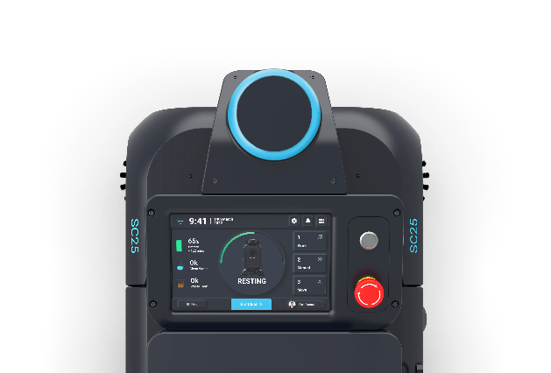
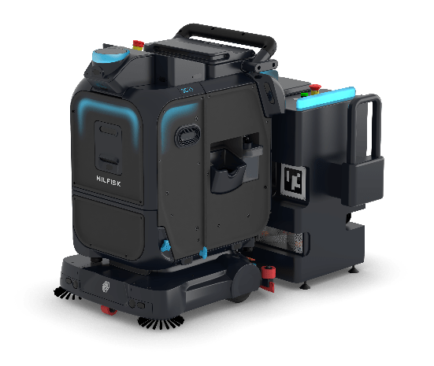
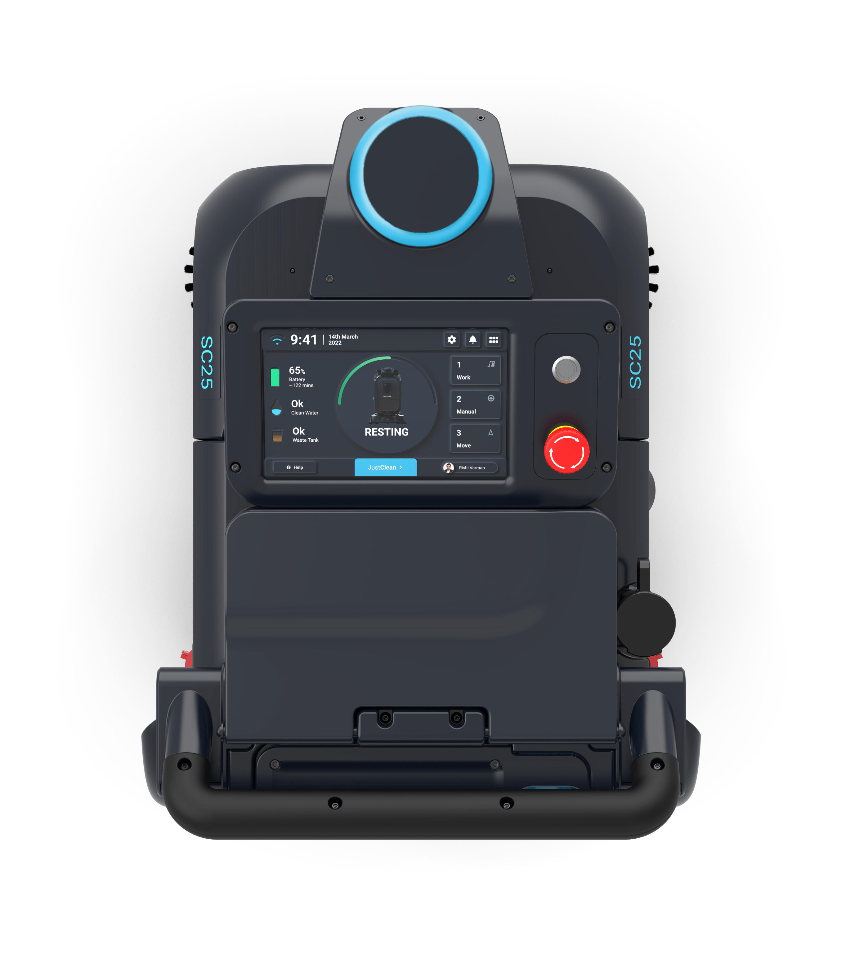
Reference guide
Table 1
No. | Robot specifications | SC25
1 | Dimensions (L * W * H) | 722mm (28.4in) * 654mm (25.7in) * 911mm (35.8in)
2 | Cleaning Runtime | 1.5 to 3 h depending on solution flow
3 | Realistic Cleaning Efficiency | 350to 800 m²/h
4 | Ideal size of cleaning area | Less than 2400 m²
5 | Debris Tray Capacity | 0.8 L
6 | Refuel Station | Auto charging, auto refill & drain water
7 | Storage area required for docking station | See description below
8 | Min. Detectable Height | 5 cm
9 | Min. Door Width (for robot to move through autonomously) | See description below
10 | Min. Cleaning Aisle Width (for robot to turn smoothly while cleaning) | See description below
11 | Max 2D Lidar Range | See description below
12 | Max 3D Lidar range – mandatory for dynamic and constantly changing environments (e.g. retail stores, large sportshall > 25 m wide) | See description below
7
9
10
0.9 m (35.4 inches)
1.3m (51.1 inches)
11
12
25 m
120 m
2 m (6.4 feet)
2 m (6.4 feet)

Slide 6














Reference guide
Table 2
Type of environment to clean | Photo examples
Easy Wide open spaces with minimal obstacles so that robots can move in long, straight paths.
Medium Open but irregular spaces so robot need to navigate around obstacles and light human traffic.
Difficult Very narrow spaces with a lot of human traffic and dynamic obstacles that obstruct robot’s path.
Table 3
Traps (red flags for robots) | Photo examples
Flammable / corrosive liquids Risk of damage if corrosive liquids suck into robot or static buildup sparks off flammable liquids.
Layout change frequently Seasonal pop-ups, moveable racks, tables and chairs will keep moving around – 3D lidar mandatory otherwise and users have to constantly update the cleaning map.

Slide 7









Reference guide
Table 3
Traps (red flags for robots) | Photo examples
Strong light reflection on ground Bright lights affect the camera and robot will think it is a hole in the floor, causing it to stop.
Doors / aisles < robot min door width SC25 can be challenged in moving with spaces 0.9m.
Table 4
Traps (set as restricted zones) | Photo examples
Slopes Robot will struggle and risk not to run in areas with slopes / ramps due to sensors positioning.
Stairs / Escalators / Travelator Risk of robot falling off stairs / escalators. It is also unable to come out of travelators.
Cliff / Ledge / Drain Risk of robot falling off cliffs and ledges at the edge of cleaning area. Wheel can also get trapped in drains.

Slide 8
















Reference guide
Table 4
Traps (red flags for robots) | Photo examples
Glass doors / walls / plastic curtains SC25 can detect glass through ultrasonics, however it’s recommended to set a restriction zone to avoid robot risking getting too close to the object
Loose cables / cable trunking Risk of cables getting stuck in wheels, brush or vacuum. Trunking will obstruct the cleaning path – be mindful, remove or set a restrict zone
Tactile / uneven floors Going over these tactile studs or rough floors will damage the robot wheels & cleaning tools
Carpet Carpets will be damaged if scrubbed or might get dragged by vacuum / wheel if unsecured.
Low height obstacles < 5cm Risk of robot hitting into object or platforms as robot can only detect objects at least 5 cm high.
Overhang objects / protruding structures Risk of hitting overhangs if robot only detect the object’s base which is smaller (e.g. high tables with thin legs, clothes rack, displays on shelves)

