Slide 1
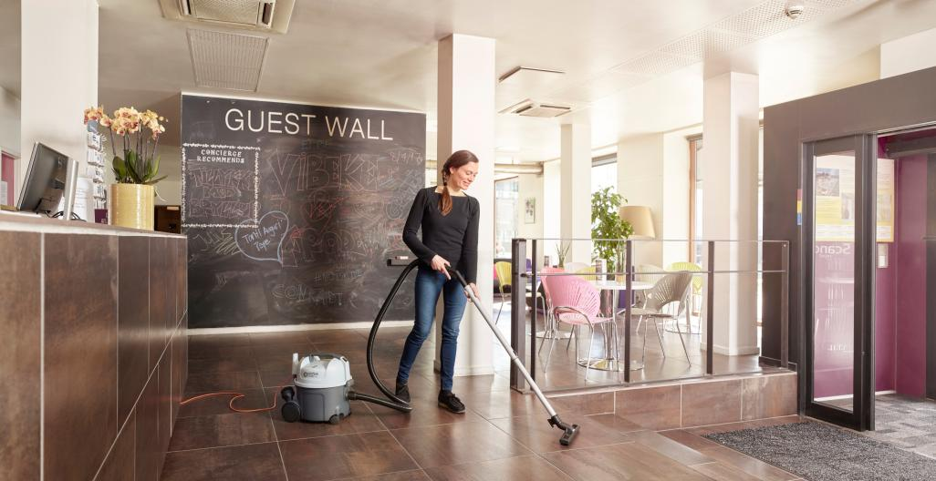
VP300 HEPA
Sales & Technical presentation

Slide 2
Contents
1
Background
6
VP300 R
2
Product Summary
7
Technical Specification
3
Primary Areas of Applications
4
Customer Benefits
5
Features

Slide 3
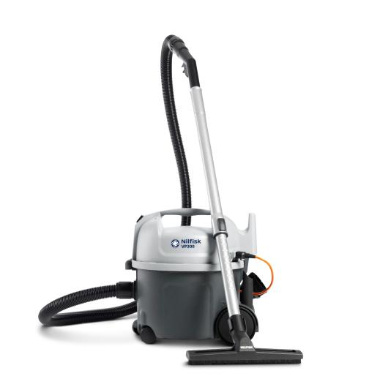
Background
Truly outstanding. Simply reliable. Highly affordable.
The Nilfisk VP300 is a basic, well-built, thoroughly reliable vacuum cleaner designed with careful attention to both comfort and the environment.
The Nilfisk VP300 series is fitted with a certified HEPA filter which effectively removes dust, pollen, mold, bacteria, and any airborne particles. A fighting weight of only 5,5 kg makes it easy to move around, and with a sound pressure of only
62 dB(A), the equivalent of a quiet refrigerator, it is suitable for daytime cleaning.
SALES & TECHNICAL PRESENTATION VP300 HEPA
4/29/2024

Slide 4
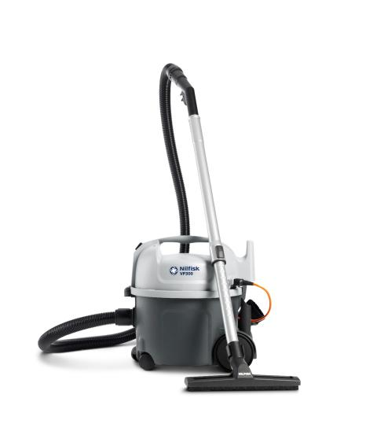
Product summary
Ergonomic carrying handle
Cord storage
Durable on/off switch
Convenient tube parking
HEPA and sack filter included
Detachable cord*
Secure single locking mechanism
Discreet and secure tool holders
Threshold bumper mid castors
Available with various accessories
*selected models

Slide 5
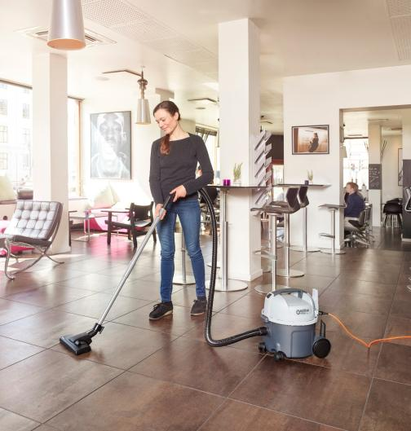
Primary areas of applications
The VP300 HEPA is the ideal cleaner for the customer who requires a reliable economic machine with that little bit extra:
Hotels
Reception areas
Offices
Shops
Schools/universities
The VP300 HEPA should be run for up to several hours per day in areas that are cleaned regularly.
SALES & TECHNICAL PRESENTATION VP300 HEPA
4/29/2024

Slide 6
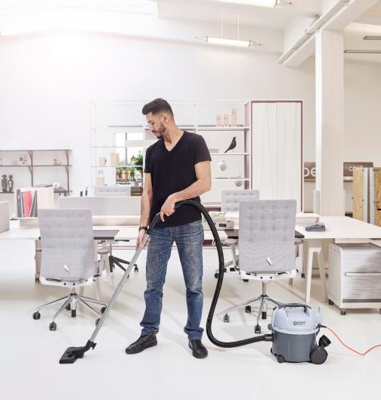
Customer benefits
Key selling points
Low noise level compared to positioning; Sound pressure level of 62 dB(A), reduces disturbance when cleaning in occupied areas
Certified HEPA filter for cleaner environment
Detachable cord, minimizes downtime (selected models)
Orange cord, minimizes the risk of people tripping (selected models; mainly detachable)
Low weight, for easy portability and user friendliness
High quality accessories, ensures good cleaning performance
High net filling capacity – one of the best in class, saves you money on maintenance
SALES & TECHNICAL PRESENTATION VP300 HEPA
4/29/2024

Slide 7
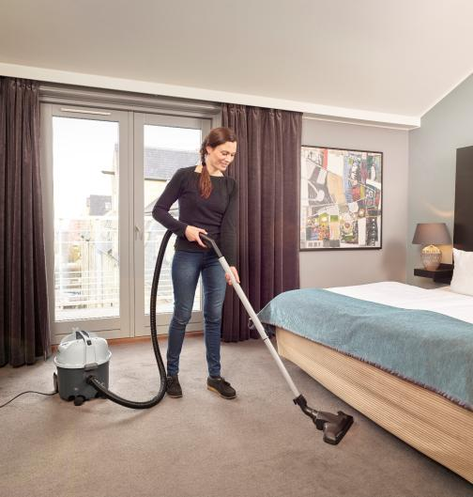
Features
Productivity
Suitable for up to several hours of continuous vacuuming per day
10 ltr. dust bag capacity
Certified HEPA filter
High quality accessories for good cleaning performance
Sound pressure of 62 dB(A), reduces disturbance when cleaning in occupied areas during e.g. daytime
Detachable cord ensures no service down time (selected models)
SALES & TECHNICAL PRESENTATION VP300 HEPA
4/29/2024

Slide 8
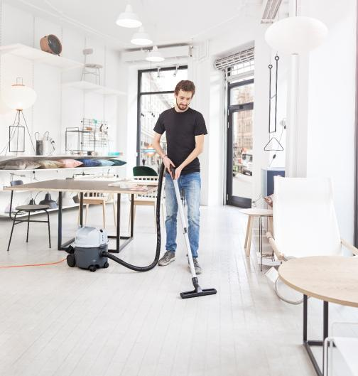
Features
Ease of use
Low weight for easy transport between locations
Ergonomic carrying handle
Secure and easy accessible accessories (brush and crevice nozzle)
Stability & balance, intuitively follows the user without tipping over
Easily removable top cover for dust bag change
Convenient tube parking
Cord storage on rear hook
Compact to store
SALES & TECHNICAL PRESENTATION VP300 HEPA
4/29/2024

Slide 9
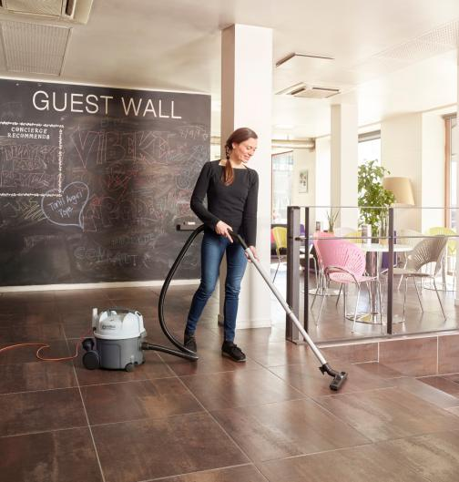
Features
Reliability
Protective rear wheel covers
Front castors fitted into container wall
Non marking rubber body bumper
Threshold bumper protect wheels when moving over thresholds from room to room
Durable on/off switch for foot maneuverability
GM 80 proven carry over detachable cord design
SALES & TECHNICAL PRESENTATION VP300 HEPA
4/29/2024

Slide 10
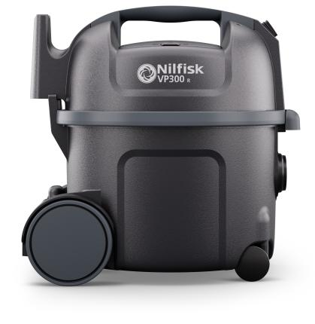
Introducing the Nilfisk VP300 R
Background for updating the existing VP300
Reason for developing the VP300 R:
Increased focus on sustainable products led us to update our VP300 range with a model with 30% PCR plastic. This strategic move aligns with customer demand for sustainability and enhances our competitive market position.
Product highlights: Made out of 30% sustainable PCR plast
The VP300 R retains the reliable and durable features of the original VP300 series, making it suitable for daily use in various applications such as offices, hotel rooms, and retail outlets.
It stands out with a composition of 30% Post Consumer Recycled (PCR) plastic mixed with 70% virgin plastic. This sets it apart from competitors like Kärcher’s Re!Plast and Numatic’s ERP180 ReFlo, which use solely Post Industrial Recycled (PIR) plastic
The VP300 R has 18 plastic components, each composed of 30% PCR Recycled material, spanning a total of 11 recycled materials.
Using PCR plastic, not PIR plastic, makes us uniquely sustainable. Our process is third-party verified for credibility.

Slide 11
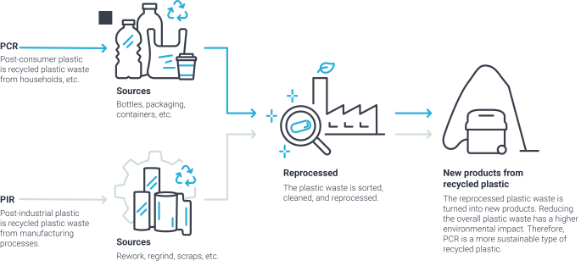
PCR vs. PIR explainer
What is the difference between PCR/PIR plast
PCR is made from plastic waste like bottles, packaging, and containers from households, etc.
PIR is made from plastic waste generated from the manufacturing process like rework, regrind, and scraps.
In short, PCR is a more sustainable type of recycled plastic. Reducing the overall plastic waste has a higher environmental impact.

Slide 12
Technical specifications
 | VP300 ECO HEPA EU | VP 300 R HEPA EU | VP300 HEPA BASIC EU | VP300 HEPA BASIC EU2 | VP300 HEPA NORDIC | VP300 HEPA EU1 | VP300 HEPA EU2
Rated power (W) | 400 | 800 | 800 | 800 | 800/400 | 800/400 | 800/400
Suction power end of tube (W) | 110 | 215 | 215 | 215 | 215/110 | 215/110 | 215/110
Airflow (l/sec.) | 25 | 25 | 25 | 25 | 32/25 | 32/25 | 32/25
Dust bag capacity (l) | 10 | 10 | 10 | 10 | 10 | 10 | 10
Length x width x height (mm) | 395x340x390 | 395x340x390 | 395x340x390 | 395x340x390 | 395x340x390 | 395x340x390 | 395x340x390
Cable length (m) | 10 | 10 | 10 | 10 | 15 | 15 | 10
Weight (kg) | 5 | 5,5 | 5,5 | 5,5 | 5,5 | 5,5 | 5,5
Item no. | 107415311 | 107421140 | 107415322 | 107421301 | 1074142284 | 41600870 | 41600871

Slide 13
Features
 | VP300 ECO HEPA EU | VP 300 R HEPA EU | VP300 HEPA BASIC EU | VP300 HEPA BASIC EU2 | VP300 HEPA NORDIC | VP300 HEPA EU1 | VP300 HEPA EU2
Detachable cord |  |  |  |  | • | • | •
With fixed cord | • | • | • | •
Dust bag 1 pcs. | • | • | • | • | • | • | •
HEPA filtration | • | • | • | • | • | • | •
Two speed |  |  |  |  | • | • | •
H13 Exhaust filter | • | • | • | • | • | • | •

Slide 14
Accessories
 | VP300 ECO HEPA EU | VP 300 R HEPA EU | VP300 HEPA BASIC EU | VP300 HEPA BASIC EU2 | VP300 HEPA NORDIC | VP300 HEPA EU1 | VP300 HEPA EU2
Hose CPL D32 | 147 0765 500 | 147 0765 500 | 147 0765 500 | 147 0765 500 | 147 0765 500 | 147 0765 500 | 147 0765 500
Extension tube alu. |  |  |  |  |  |  | 011 6431 500
Telescopic tube acc. | 107403804
Telescopic tube alu. |  |  |  |  | 011 8130 500 | 011 8130 500
Crevice Nozzle | 107408039 | 107408039 | 107408039 | 107408039 | 107408039 | 107408039 | 107408039
Brush Nozzle D32 |  | 140 8244 500 | 140 8244 500 | 140 8244 500 | 140 8244 500 | 140 8244 500 | 140 8244 500
Crevice Nozzle D32 L153 Black |  |  |  |  | 147 0146 500 | 147 0146 500 | 147 0146 500
Combi Nozzle RD295P w. Clip |  |  |  | 107417790
NA38 Combi Nozzle WO Click Kit | 107418965
Nozzle Multi Surface 32 MM |  | 140 6700 540 | 140 6700 540 |  | 140 6700 540 | 140 6700 540 | 140 6700 540
Sack Filter | 147 1432 500 | 147 1432 500 | 147 1432 500 | 147 1432 500 | 147 1432 500 | 147 1432 500 | 147 1432 500
HEPA Filter H13 | 147 1250 600 | 147 1250 600 | 147 1250 600 | 147 1250 600 | 147 1250 600 | 147 1250 600 | 147 1250 600
Detach Cord Set 10m Orange EU |  |  |  |  |  |  | 107402676
Detach Cord Set 15m Orange EU |  |  |  |  | 107402901 | 107402901
Extension Tube Steel D32 |  | 140 8246 040 | 140 8246 040 | 140 8246 040
Item no. | 107415311 | 107421140 | 107415322 | 107421301 | 1074142284 | 41600870 | 41600871

Slide 15
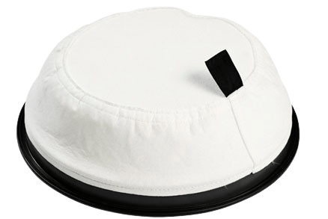
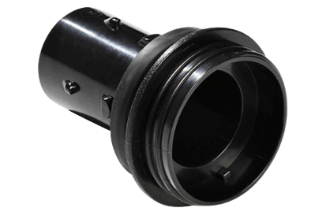
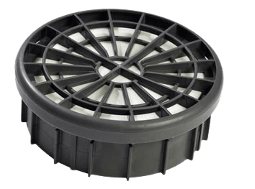
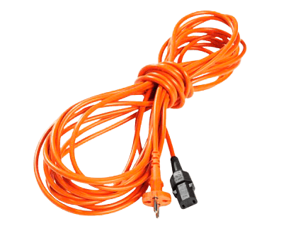
Accessories
HEPA 13 filter | 147 1250 600
Sack filter | 147 1432 500
Disposable fleece bags 10 Ltr, 10 pack | 82367820
Disposbale paper bags 10 Ltr, 5 pack | 82367810
Disposable paper bags 10 Ltr, 10 pack | 140 8618 000
Detachable cord 15 meter EU, orange | 107402901
Detachable cord 10 meter EU, orange | 107402676
Detachable cord 10 meter UK, orange | 107402677
Detachable cord 10 meter AU/NZ, orange | 107402678
Numatic Adaptor (20 pcs.) | 107401199
SALES & TECHNICAL PRESENTATION VP300 HEPA
4/29/2024

